Slide 1
ANTITUSSIVES

Slide 2
Antitussives:
Antitussives are drugs that suppress coughing, possibly by reducing the activity of the cough center in the brain.
Antitussive agents are used to relieve dry cough.

Slide 3
Cough
Cough is protective reflex, its purpose being expulsion of respiratory secretions or foreign particles from the lungs and upper airway passages.

Slide 4
Mechanism of cough:

Slide 5
Types of antitussives
Centrally acting antitussives:
narcotics (e.g codeine, hydrocodone)
Addictng
Non addicting
non-narcotics
Opioid derivativs e.g dextromethorphan).
Non opioid
Locally acting agents (e.gdemulsent throat lozenges,
steam enhalent
Local anesthatic

Slide 6
Centrally acting antitussives:
narcotics:
Codeine, hydrocodone

Slide 7
Codeine:
Codeine is an opioid (methylmorphine) with a relatively limited analgesic effect; it does not cause significant respiratory depressions but has good antitussive properties.
Codeine raises the stimulus threshold of the cough center and thus has a cough suppressing effect.

Slide 8
In most humans 10% of a codeine dose is transformed to morphine through demethylation in the liver. This explains the analgesic effect that is absent in individuals with the respective genetic traits.

Slide 10
Mechanism of Action:
Codeine sulfate is an opioid analgesic, related to morphine, but with less potent analgesic properties. Codeine is selective for the mu receptor, but with a much weaker affinity than morphine. The analgesic properties of codeine have been speculated to come from its conversion to morphine, although the exact mechanism of analgesic action remains unknown.

Slide 11
Pharmacokinetics:
Bioavailability 50%
Peak plasma level 1 hour
Plasma half-life 3 to 4 hours
Active metabolites several
Elimination predominantly extrarenal

Slide 12
Indications:
Codeine is the cough medicine to which all other antitussive drugs are compared.
Compared to placebos it has been demonstrated to reduce coughing by 40% with a dose of 15 mg and by 60% with a dose of 60 mg.
Other opioids such as hydrocodon are likely to be even stronger but they are also accompanied by much greater risks (respiratory depression, dependence).

Slide 13
Codeine is suitable for the treatment of mild and moderate pain.
The analgesic action of 30 mg of codeine corresponds approximately to 325-600 mg of paracetamol or aspirin.
Codeine can be combined advantageously with non-opioid analgesics. Aspirin (500 mg), paracetamol (500 mg), or other more recent non-steroidal anti-inflammatory agents can be suitably combined with codeine (30 mg). Such combinations can be used after dental surgery or for tumor pains.

Slide 14
Adverse Reactions
Retention of urine
itching
vertigo
palpitations or bradycardia
sweating
mild central nervous effects

Slide 15
Interactions:
The effect of codeine is increased by other drugs with centrally suppressing effects (e.g. alcohol) and by the enzyme inhibitor cimetidine.
Neuroleptic and antidepressive agents can competitively inhibit the enzyme responsible for the analgesic effect of codeine

Slide 16
Expectorants:
Expectorants are agents given orally to liquefy respiratory secretions and allow for their easier removal.
Guaifenesin is the most commonly used expectorant. It is available alone and as an ingredient in many combination cough and cold remedies, although research studies do not support its effectiveness and many authorities do not recommend its use.

Slide 17
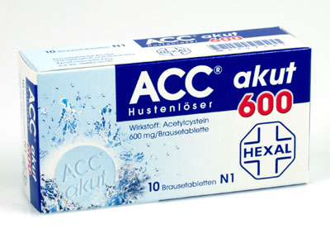
Expectorants:
Other expectorants (hot beverages, potassium iodide, and ipecac) stimulate production of watery mucus.

Slide 18
Guaifenesin:
Guaifenesin is an expectorant, the action of which promotes or facilitates the removal of secretions from the respiratory tract.

Slide 19
Mechanism of action:
By increasing sputum volume and making sputum less viscous, guaifenesin facilitates expectoration of retained secretions.

Slide 20
Pharmacokinetics
Absorption
Readily absorbed.
Elimination
The half-life is 1 h; renal excretion; major urinary metabolite is beta-2-(methoxyphenoxy) lactic acid

Slide 22
Indications:
Temporarily relieves cough due to minor throat and bronchial irritation as may occur with the common cold or inhaled irritants.
Calms the cough control center and relieves coughing.
Helps loosen phlegm (mucus) and thin bronchial secretions to rid the bronchial passageways of bothersome mucus, drain bronchial tubes, and make coughs more productive.

Slide 23
Adverse Reactions:
Dizziness,
Headache and rash (including urticaria).
Rare drowsiness or mild gastrointestinal disturbances are the only side effects associated with extromethorphan in clinical use.

Slide 24
Mucolytics:
Mucolytics are administered by inhalation to liquefy mucus in the respiratory tract. Solutions of mucolytic drugs may be nebulized into a face mask or mouthpiece or instilled directly into the respiratory tract through a tracheostomy.
Sodium chloride solution and acetylcysteine (Mucomyst) are the only agents recommended for use as mucolytics.

Slide 25
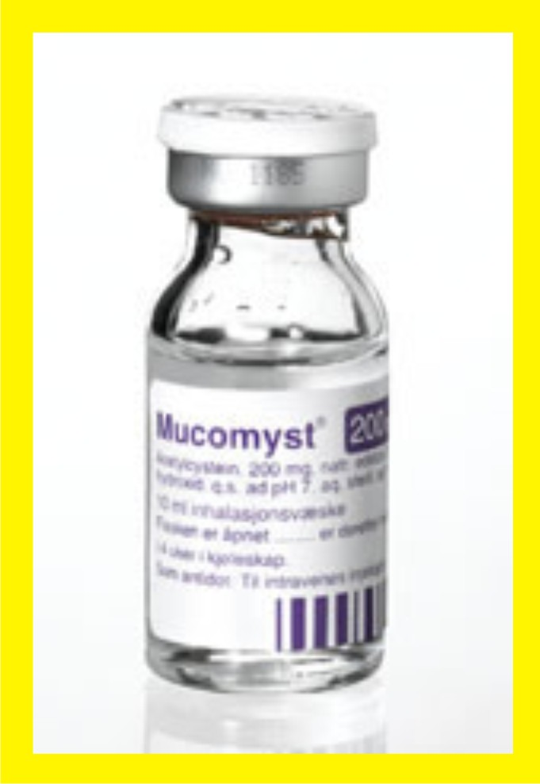
Acetylcysteine
Acetylcysteine is effective within 1 minute after inhalation, and maximal effects occur within 5 to 10 minutes. It is effective immediately after direct instillation.
Oral acetylcysteine is widely used in the treatment of acetaminophen overdosage

Slide 26
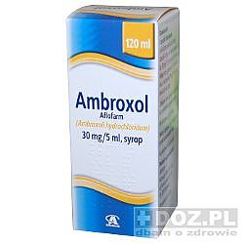
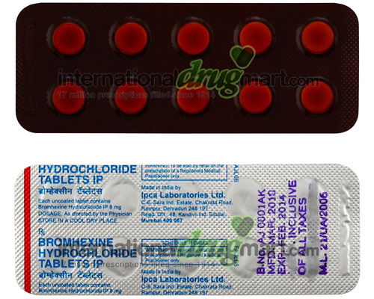
Other Expectorants
Expectorants like bromhexine or ambroxole may effectively decrease viscosity of bronchial secretions

Slide 27
References
https://online.epocrates.com/u/10736/guaifenesin/Pharmacology
http://www.drugs.com/pro/guaifenesin-dm-nr.html
http://www.infomed.ch/100drugs/codphar.html
http://www.rxlist.com/codeine-sulfate-drug/clinical-pharmacology.htm
http://www.medindia.net/doctors/drug_information/hydrocodone_chlorpheniramine.htm
http://www.medindia.net/drugs/therapeutic-classification/antitussives.htm
http://www.drugs.com/drug-class/antitussives.html

