Slide 1
Bedside Approach to Respiratory Case
Dr Manish Chandra Prabhakar
MGIMS Sewagram, India

Slide 3
Symptoms
Cough
Dyspnea
Chest Pain
Hemoptysis
Wheeze / Stridor
Hoarseness of voice

Slide 4
Cough
Reflex act of forceful expiration against a closed glottis.
Clear the airways.

Slide 5
Cough
Is it acute, subacute or chronic?
Dry or Productive?
Associated symptoms – fever, dyspnea, chest pain, etc.?
Risk factors – Smoking, environmental factors, HIV, family h/o TB ?
Symptoms of postnasal discharge, GERD?
Is the patient on ACE inhibitor?

Slide 6
Acute cough <3 wks
URI
Pneumonia
Pulmonary embolism
CCF

Slide 7
Subacute cough (3- 8 weeks)
Viral infections
Post infectious
Post nasal drip
GERD

Slide 8
Chronic cough >8 wks
Pulmonary TB
Br Asthma
COPD
Bronchogenic ca
Eosinophilic bronchitis
Post nasal drip
GERD

Slide 9
Nocturnal cough
Post nasal drip.
GERD
Chronic brochitis.
Bronchial asthma.
Obstructive sleep apnea
LVF

Slide 10
Sputum
Consistency
Amount
Color
Postural variation
Smell

Slide 11
Consistency
Serous
Mucoid
Mucopurulent
URI
Bronchoalvelolar ca
Chronic bronchitis,
Br Asthma
Bacterial infection.

Slide 12
Sputum
Copious Amount
Bronchiectasis
Lung Abscess
Necrotizing pneumonia
Alveolar cell ca
Empyema rupturing into bronchus
Postural variation
Lung Abscess
Bronchiectasis

Slide 13
Color of sputum
Yellow / Green — Bacterial infection
Black — coal worker pneumoconiosis
Pink frothy sputum — Pulmonary edema
Anchovy sauce — Ruptured amoebic liver abscess.

Slide 14
Foul Smell —
Lung abscess
Bronchiectasis
Anaerobic bacterial infection.

Slide 15
Dyspnea :-
Subjective experience of breathing discomfort that consists of qualitatively distinct sensations that vary in intensity.
Occurred within – minutes, hours to days, weeks to months.

Slide 16
Dyspnea
Within minutes
Pneumothorax
Pulmonary embolism
Inhalation of foreign body
Larygeal edema
Left heart failure

Slide 17
Dyspnea
Hours to Days
ARDS
Br Asthma
Pneumoia
Left heart failure

Slide 18
Dyspnea
Weeks to Months
COPD
ILD
Pleural effusion
Anemia
Thyrotoxicosis

Slide 19
Haemoptysis
Mild <100ml /day
Massive > 600ml /day or 100ml/day for more than 3 days.

Slide 20
HAEMOPTYSIS | HAEMATEMESIS
Cough precedes | Nausea & vomiting precedes
Frothy | not
pH alkaline | pH acidic
Bright red | Dark brown
H/o respiratory ds | h/o peptic ulcer ds
Not | h/o malena
bronchoscopy | endoscopy

Slide 21
Causes--
Infection—
TB
Lung Abscess
Bronchiectasis
Pneumonia
Fungal infection (aspergillosis, blastomycosis)
Neoplasm---
Bronchogenic ca
Bronchial adenoma
Metastatic tumour

Slide 22
Causes--
CVS—
MS
PHT
Pulmonary embolism
AV malfromation
Collagen vascular disorder
Vasculitis
Wegener’ s granulomatosis
Goodpastures’s syndrome
Traumatic
Iatrogenic..
Bleeding disorder

Slide 23
Chest Pain
Site
Character
Associated sx
Aggravating/Relieving factor

Slide 24
Retrosternal Pain :-
Upper
Tracheatis
Mid and Lower
Mediastinitis
Mediastinal tumor
GERD
Achalasia cardia

Slide 25
Pleural Inflammation – Catchy pain, increases on deep inspiration and on pressure.
Pancoast tumor – shoulder and arm pain due to compression of C8, T1-2 roots.
Erosion of ribs – constant chest pain.
Tietze’s syndrome – costochondritis
Always keep ‘Angina’ in mind.

Slide 26
General Examination
Vitals
Temperature
Pulse
Respiratory Rate & Breathing pattern.
Blood pressure
Anemia
Icterus
JVP
Cyanosis
Clubbing
Lymphadenopathy
Pedal oedema

Slide 27
General condition--
Built
Nourishment
Tripod position
Purse lip breathing
Paraneoplastic syndrome

Slide 28
Pulse
Bradycardia - Hypoxia.
Tachycardia - Pneumonia , Pulmonary Embolism, ARDS
Unequal - Pancost Tumour , Mediastinal syndrome.
Pulsus Paradoxus – Ac severe asthma, COPD
Collapsing /bounding pulse — CO2 narcosis.

Slide 29
Blood Pressure
Pulsus Paradoxus
Pancoast’s tumor
Mediastinal syndrome

Slide 30
Respiratory Rate & Breathing Pattern--
Tachypnoea > 20
Causes
Pneumonia
Acute pulmonary odema
Pulmonary embolism
ARDS
Metabolic acidosis
Others causes
Fever , hypoxia, excitation, nervousness

Slide 31
Respiratory Failure
Hypoxia
Irritability
Disorientation/Confusion
Somnolence
Bradycardia
Cyanosis
Seizures
Hypercapnea
Anxiety
Delirium
Confused
Somonolence
Flapping tremors/Asterixis
Thready or bounding pulse
Papillodema
Seizures

Slide 32
Examination of EYE
Finding on Examination | Likely Etiology
Horners syndrome | Pancost tumour
Phlycten, choroid tubercule | Tuberculosis
Conjunctival chemosis | SVC Syndrome, CO2 narcosis
Papilloedema | SVC obstruction, CO2 narcosis

Slide 33
Anemia
Chronic Infections – TB
Chronic inflammatory disorders – ILD, CTD.
Malignancies.

Slide 34
Icterus
Iatrogenic - ATT
Metastasis to Liver
Pulmonary infarction.
Sepsis – secondary to chest infection.

Slide 35
JVP
SVC obstruction—Mediastinal Syndrome
Cor pulmonale.

Slide 36
Cyanosis
Respiratory disorders
Acute severe Asthma
Tension Pneumothorax
Pulmonary AV malformations
Acute laryngeal oedema
ARDS

Slide 37
Lymphadenopathy
Lymphatic drainage :
Parietal Pleura – Multiple nodes
Rt lung + Lt lower lobe — Rt supraclavicular LN
Left upper lobe — Lt supraclavicular LN (Troisier’s sign).
Apical portion drains directly in scalene LN.

Slide 38
Lymphadenopathy
Sites
Number
Tender/Non-tender
Discrete/matted
Consistency
Fixed/Mobile
Overlying skin
Sinus

Slide 39
Causes--
URI
Tuberculosis
HIV
Sarcoidosis
Lung Carcinoma
Lymphoma
Secondaries

Slide 40
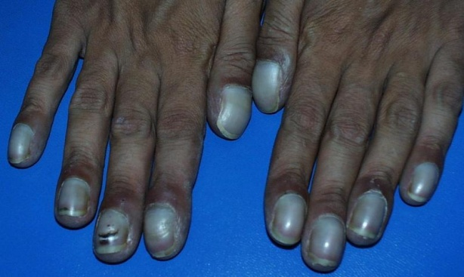
Clubbing
Causes
Bronchogenic ca
Bronchiactasis
Lung abscess
Empyema
Cystic fibrosis
Interstitial lung ds
Unilateral clubbing — Pancoast tumour

Slide 41
Pedal Edema
Cor Pulmonale
Chronic infections / inflammations – secondary to hypoalbuminemia.
A/w renal involvement – WG, PAN, Microscopic polyangitis, SCLC.

Slide 42
Examination of Respiratory System--
Inspection of Upper Respiratory Tract—
Oral cavity
Oral hyagine
Dental caries
Oral thrush
Tonsils

Slide 43
Examination of Respiratory System--
Inspection of Upper Respiratory Tract—
Nose & Sinuses
DNS—Recurrent resp iration infection
Nasal polyp-Cystic fibrosis, allergic asthma, ABPA, Wegener’s granulomatosis.
Phaynx- Post nasal drip, lymhoma deposits.

Slide 44
Inspection
Symmetry of chest
Position of Trachea
Position of Apex impulse
Movements of chest
Accessory muscles
Hollowness/Bulging/flattening/retraction/
crowding of ribs
Drooping of shoulders
Spino-scapular distance
Kyphosis / Scoliosis.
Scar/sinus/dilated veins.

Slide 45
Areas
Anteriorly
Supraclavicular
Infraclavicular
Inframammary
Laterally
Axillary
Infraaxillary
Posteriorly
Suprascapular
Interscapular
Infrascapular

Slide 46
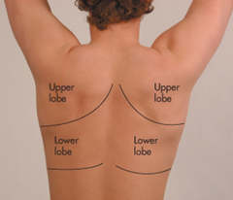
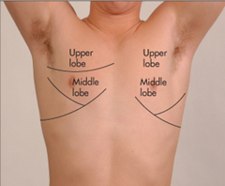
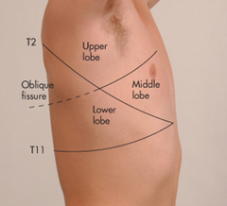
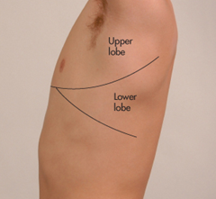

Slide 47
Symmetry of chest--
Flat chest (1:2) — Pulm TB,Fibrothorax
Barrel chest-(1:1) — COPD (Emphysema)
Pectus carinatum -- rickets, marfan’s syndrome, Down’s, Noonan, osteogenesis imperfecta.
Rickety rosary — rickets.
Scorbutic rosary - Vit C Def.
Harrisons sulcus — chronic respiratory ds in childhood, rickets, blocked nasopharynx due to adenoid enlargement.
Pectus excavatum (cobbler’s chest or funnel chest)--Marfan’s syndrome, spinal muscular atrophy.

Slide 48
Symmetry of chest--
Spinal deformity — Kyphosis , Scoliosis.
Bulging — Pleural effusion, Pneumothorax, empyema necessitans. Tumour
Flattening or depression — Fibrosis, Collapse.

Slide 49
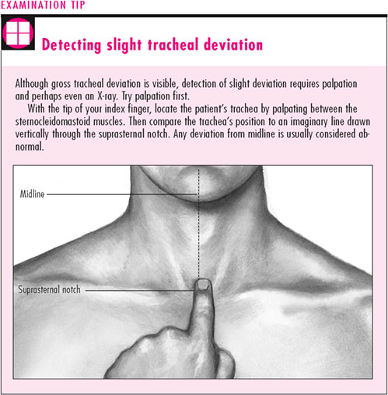
Position of Trachea/Apical impulse--
Opposite side | Same side | Central
Pleural effusion | Fibrosis | Consolidation
Pneumothorax | Collapse of lung | Loculated Effusion / Empyema
Mediastinal Mass |  | Br Asthma
 |  | Bronchitis
 |  | Bronchiectasis

Slide 50
Scar
Strenotomy scar
Valvotomy scar
Lobectomy/Pnemonectomy scar
IC Tube scar

Slide 51
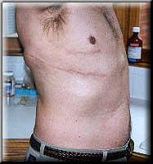
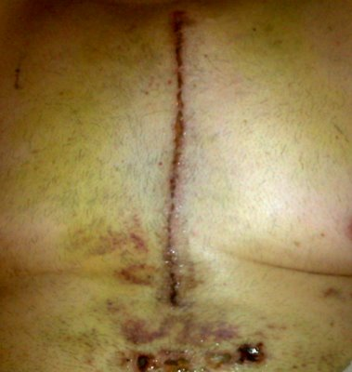

Slide 52
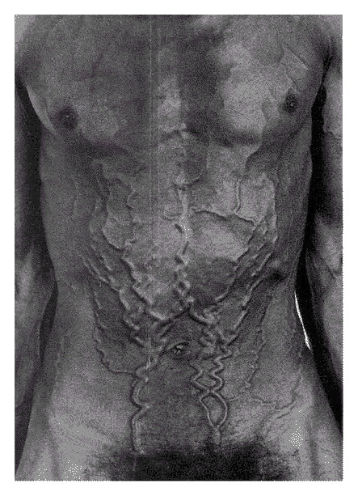
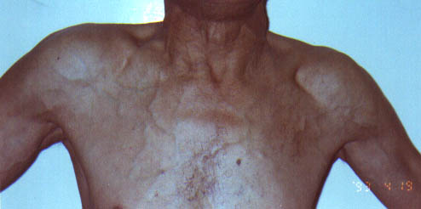
Dilated Veins
SVC syndrome

Slide 53
Palpation
Temperature
Tenderness
Position of trachea and apex beat
Movement of chest
Chest expansion
Tactile vocal fremitus
Others – flow in dilated veins, subcutaneous emphysema.

Slide 54
Position of Trachea/Apex beat
Conditions as listed in Inspection.
TRACHEAL TUG (OLIVERS SIGN) – Downward displacement of the cricoid cartilage with ventricular contraction – An AORTIC ARCH ANEURYSM
TRACHEAL TUG (CAMPBELL’S SIGN) – Downward displacement of thyroid cartilage during inspiration – COPD

Slide 55
Local pain / tenderness
Empyema
Infiltration of chest wall by tumor
Osteomyelitis
Costochondritis
Herpes zoster

Slide 56
Chest expention – Normal 2 inch
< 1.5 inch..abnormal
Chest movements are assessed in all areas.
Inspection is better then palpation (for movements)

Slide 57
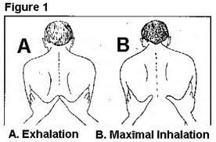
Chest expansion
General Restriction
Extensive bilateral ds
COPD
ILD
Ankylosing spondylitis
Spinal deformity
Asymmetrical expansion
Pleural effusion
Pneumothorex
Consolidation
Collapse
Fibrosis

Slide 58
Tactile Vocal Fremitus
Sound produced at larynx
Vibration transmitted to periphery of lung.
Lung vibrate secondary to larynx vibration.
Perceived on chest wall by palpating surface of hand.

Slide 59
Tactile Vocal Fremitus
Increased
Consolidation
Collapse with patent bronchus
Cavity with communicating bronchus
Decreased
Pleural effusion
Pneumothorax
Bronchial obstruction
Pneumonectomy

Slide 60
Percussion
Conventional percussion
Tidal percussion
Hepatic and cardiac dullness

Slide 61
Percussion
Position of Patient : Sitting
Anterior – Hands by the side
Posterior – Hands over opposite shoulders
Lateral – Hands over head.

Slide 62
Percussion
Resonant - normal lung
Tympanic – Hollow viscous
Hyper-resonant - Pneumothorax
Impaired - Pulmonary fibrosis.
Dull – Consolidation, Collapse, Pleural thickening
Stony dullness– pleural effusion, empyema.

Slide 63
Percussion
Kronig’s isthmus
Band of resonance 5 to 7cm over suraclavicular fossa
Medially — scalnus ms
Laterally - acromian process of scapula
Anteriorly — Clavicle
Posteriorly — Trapezius
Hyperresonant — Emphysema, Hydropneumothorex
Impaired dullness — Fibrosis, UL collapse, Mass

Slide 64
Percussion
Clavicle percussion( medial 1/3rd)
Tidal percussion
Traube’s percussion
Grocco’s triangle—A right angle triangle of dullness at the base of the chest near the spinal column (paravertible ) on the side opposite a pleural effusion.
Skodiac Resonance – Hyperresoanant sound generated by percussion of the chest above a pleural effusion.

Slide 65
Auscultation

Slide 66
Type / Nature
Vesicular
Soft, Low pitched
~ 100 Hz
Gentle rustling
Continuous
Inspiration > Expiration
3 : 1
Bronchial
Loud, High pitched
300 – 400 Hz
Hollow
Pause
Inspiration = < Expiration

Slide 67
Bronchial breathing
Airway Airless lung Loss of filtration effect BB
e.g. - Consolidation - Collapse (with patent bronchus)
- Fibrosis - Upper level of pleural effusion
- Cavity - Bronchopleural fistula
Cavity filled with fluid NO BB
Tense pleural effusion BB all over

Slide 68
Vocal resonance
Test Elasticity of Lung
Sound of patient’s voice heard through stethoscope placed on the patient’s chest
Normal lung – Low pass filter
Transmits sound frequency <200 Hz
Normal speech – Low pitch,
Muffled, indistinct
Unintelligible words

Slide 69
Bronchophony
Ask patient to say ‘Ek Do Teen’/ ‘1,2,3’ / ‘99’
Auscultate over periphery of the lung
Sounds as clear as over trachea
But words are not differentiable
As if words are emitted directly into stethoscope
Seen in Consolidation
Collapse with patent bronchus Cavity
Upper level of pleural effusion

Slide 70
Decreased vocal resonance
Occlusion of bronchus
Pleural effusion
Pneumothorax

Slide 71
Whispering pectoriloquy
Whisper >400 Hz
Pectoriloquy  Words are intelligible
Whispering pectoriloquy  Whispered speech
becomes intelligible during chest auscultation
Ask patient to whisper ‘Ek Do Teen’
Auscultate over trachea & note clarity
Auscultate over periphery of the lung
Sounds as clear as over trachea

Slide 72
Egophony
Has a nasal or bleating quality
Ask patient to say ‘eee’
Auscultate over periphery of the lung
Sound appears as ‘aaa’

Slide 73
Crackles
Short, Explosive, Discontinuous Nonmusical sounds
Bubbling / clicking /Explosive sounds
Mechanism:
Flow of air through secretions
Sudden opening of a succession of small airways, due to rapid equalization of pressure between 2 airway compartments
Types—Fine—Arise from alveoli
Coarse—Arise from bronchus & Bronchioles.

Slide 74
Crackles
Crackles without sputum production—Interstitial lung ds
Crackles with sputum production– Parenchymal Lung ds.
Crackles auscultated during early inspiration --more indicative of airways disease, such as chronic bronchitis, emphysema, and asthma.
Crackles auscultated during late inspiration --more suggestive of parenchymal disorders, such as pulmonary fibrosis, interstitial pneumonitis, and pneumonia.

Slide 75
Timing
Inspiratory 1. Early : Broncho-obstructive disease
Chronic bronchitis
2. Mid : Bronchiectasis
3. Late : Alveolar disease
Pneumonia, Pulmonary edema, ILD
Expiratory – Chronic Bronchitis, ILD

Slide 76
Post- tussive crackles
Crackles disappear after coughing
- due to temporary stasis of secretions
Crackles persisting after coughing
- Pulmonary parenchymal disease, Interstitial edema
Crackles appearing after coughing
- Cavity, due to sudden opening of fibrotic walls

Slide 77
Crackles
EARLY AND MID INSPIRATORY | LATE INSPIRATORY
COARSE | FINE
LOW PITCHED | HIGH PITCHED
CLEAR WITH COUGHING | DO NOT CLEAR WITH COUGHING
SCANTY | PROFUSE
BRONCHUS & BRONCHIOLS | ALVELOLI
ASSOCIATED WITH OBSTRUCTION | ASSOCIATED WITH RESTRICTION
BRONCHITIS- BRONCHIECSTASIS | INTERSTITIAL FIBROSIS - INTERSTITIAL EDEMA

Slide 78
Wheeze
ASTHMA
BRONCHITIS
VOCAL CORD DYSFUNCTION
FOREIGN BODY ASPIRATION
INFECTIONS – CROUP LARYNGITIS
CONGESTIVE HEART FAILURE
COPD
CYSTIC FIBROSIS
ILD
FIBROSING ALVELOLITIS
NOT ALL THAT WHEEZES IS ASTHMA

Slide 79
Tone
Monophonic
Single tone at its origin
Localized narrowing of bronchus , Incomplete obstruction of principal or lobar bronchus
Eg FB, Intrabronchial growth,
Polyphonic
Multiple tones,multiple simultaneous different pitched sounds occur during expiration &
Diffuse airway disease eg Emphysema.

Slide 80
Pleural rub
Friction of inflamed visceral & parietal pleural surfaces against each other in respiration
Creaking leathery sound
During both phases
Best heard at Lateral & Posterior bases of lung

Slide 81
 | Pleural rub | Crackles
Site | Superficial & Loud | Deep
 | Continuous | Discontinuous
 | Localised | Wide area
Coughing | No change | Intensified or Abolished by coughing
Pressure of stethoscope over chest | Increases | No change
Pain & Tenderness | Present | No

Slide 82
Succusion splash
Stethoscope placed against chest wall
Shake the patient
Splashing sound
Hydropneumothorax
Gastric outlet obstruction

Slide 83
Mediastinal Crunch
Loud knocking crunching/ clicking sound
Synchronous with cardiac cycle
Heard in the center of the anterior chest.
Signifies presence of free air in the mediastinum.
Involve compression of the air by the beating heart and the mediastinal structures.
‘Hamman’s sign’

Slide 84
Mediastinal Crunch
Causes
Tracheobronchial injury due to trauma,
Medical procedures (e.g., bronchoscopy) or
Proximal pulmonary bleb rupture.
Commonly seen in Boerhaave syndrome. (oesophageal perforation due to vomiting)

Slide 85
Disease | Mediastinal shift | Percussion | Breath sounds | VR | Added sounds
Consolidation | Midline | Dull | ↑ Bronchial (tubular) | ↑, WP+ | Crackles+ Rub+/-
Fibrosis | Same side | Impaired | ↑/↓, Bronchial | ↑/ ,WP+ | Crackles+
Collapse (Major bronchus obs) | Same side | Dull | ↓ Vesicular | ↓ | None
Collapse (Patent bronchus) | Same side | Dull | ↑ Bronchial tubular | ↑ WP+ | Early – None Late – Coarse crackles

Slide 86
Disease | Mediastinal shift | Percussion | Breath sounds | VR | Added sounds
Cavity | Midline or Same side(if asso fibrosis) | Impaired | ↑ Bronchial (Cavernous) | ↑ ,WP+ | Crackles +/-
Pleural Effusion | Opposite side | Stony dull | ↓ or Absent, above level -Bronchial | or absent,↑ above | Pleural rub above level
Pneumothorax | Opposite side | Hyper-resonant | ↓ or Absent | Absent | None
Emphysema | Midline | Hyper-resonant |  | Normal or | Wheeze +/-

Slide 87
Thank You

