Slide 1
CYANOSIS
DR.TINKU JOSEPH
RESIDENT
DEPT OF PULMONARY MEDICINE
DR. D.Y. PATIL MEDICAL COLLEGE

Slide 2
DEFINITION
Bluish discolouration of the skin & mucous membrane due to presence of increased amount of reduced haemoglobin.(>5g/dl) or haemoglobin derivatives in the capillary blood.
Name is derived from the color cyan,which comes from kyanosis,Greek word blue.

Slide 3
PRINCIPLE
Deoxygenated haemoglobin is more prone to optical bluish discolouration,and also produces vasoconstriction that makes it more evident.
Scattering of color produces blue hue of veins and cyanosis.
Some colors are refracted and absorbed more than others
Darker deoxygenated blood is much more prone to blue shifting optical effects.

Slide 4
TYPES
Central cyanosis
Peripheral cyanosis
Central cyanosis
Mixed cyanosis
Differential cyanosis

Slide 5
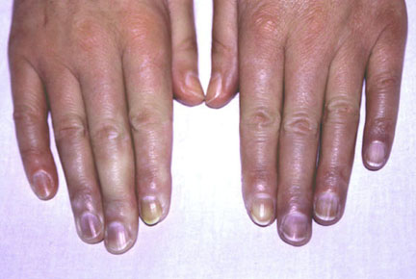
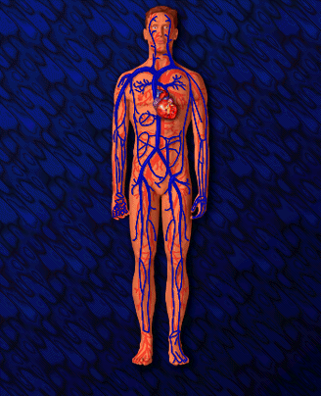
PERIPHERAL CYANOSIS
Arterial blood is normally saturated(arterial pao2 is normal) but there is oxygen unsaturation at venous end of capillary

Slide 6
MECHANISMS
Reduced cardiac output
Peripheral vasoconstriction
Slow speed of circulation in extremites

Slide 7
SITES TO BE LOOKED FOR(in good natural light)
Tip of nose
Ear lobules
Outer aspect of lips,chins,cheek
Tip of fingers and toes
Nail bed of fingers and toes
Palms and soles

Slide 8
CAUSES
Exposure to cold air or cold water(most common cause)
Frost bite
Raynauds phenomenon
Peripheral vascular disease-atherosclerosis,Buegers disease,atheroembolism
Congestive cardiac failure
Shock or peripheral circulatory failure
Venous obstruction-produces local cyanosis SVC syndrome
Hyperviscosity syndrome eg: multiple myeloma,polycythemia,macroglobulinaemia.
Cryoglobulinaemia(abnormal globulin forms gel at lower temp eg:Lymphoma)
Mitral stenosis(lips.tip of nose,cheeks in mitral facies)

Slide 9
TYPES
Generalized-cold weather,shock,low cardiac output, right heart failure, severe PAH
Localized – major vein occlusion like SVC,IVC,femoral vein

Slide 10
CENTRAL CYANOSIS
There is decreased arterial oxygen saturation due to reduction in oxygen tension in arterial blood(arterial pao2 is reduced).usually detected when the oxygen saturation of arterial blood goes below 80-85%

Slide 11
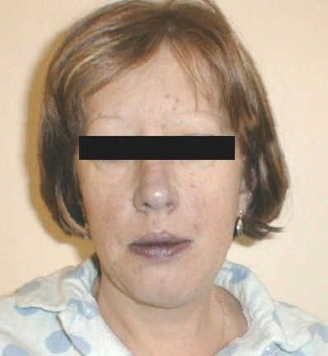
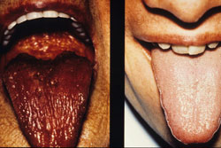
SITES
Tongue(margins,under surface)
Inner aspect of lips
Mucous membrane of gums, soft palate, cheeks
Lower palpebral conjunctiva
Plus sites mentioned in peripheral cyanosis(same deoxygenated blood circulates everywhere in the body)

Slide 12
CAUSES
RESPIRATORY
Acute severe asthma
COPD
Cor pulmonale
Respiratory failure
Respiratory depression(opium poisoning)
Lobar pneumonia
Fibrosing alveolitis
Tension pneumothorax
Acute pulmonary thromboembolism
Pulmonary atresia
Pulmonary arteriovenous malformations
Bronchiectasis
Carcinoma lung

Slide 13
CARDIAC-CAUSES
Congenital cyanotic heart disease eg: Fallots tetralogy,transposition of great vessels
Acute pulmonary edema
Eisenmengers syndrome(ASD,VSD or PDA with reversal of shunt due to development of pulmonary hypertension)
Heart failure
Tricuspid atresia

Slide 14
CONGENITAL
ASD(ostium primum)
Ebsteins anomaly(tricuspid valve deformity)
Eisenmengers syndrome
Fallots tetralogy
Patent foramen ovale
Pulmonary valve stenosis
Tricuspid valve stenosis

Slide 15
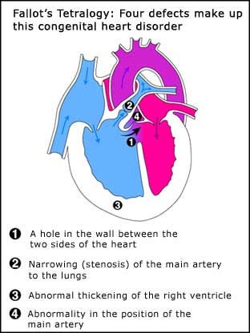

Slide 16
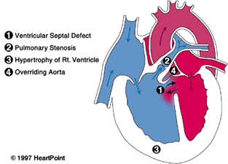

Slide 17
GASTRO
Cirrhosis of liver-portopulmonary AV shunting

Slide 18
CNS-CAUSES
Intra cranial hemorrhage
Cerebral anoxia
Drug overdose(Heroin)

Slide 19
OTHER-CAUSES
High altitude
Hypothermia
Congenital cyanosis (HbM Boston) arises from a mutation in the α-codon which results in a change of primary sequence, H --> Y. Tyrosine stabilises the Fe(III) form (oxyhaemoglobin) creating a permanent T-state of Hb.
Obstructive sleep apnea

Slide 20
 | CENTRAL CYANOSIS | PERIPHERAL CYANOSIS
SITES | COMMONLY SEEN IN WARM MUCOUS MEMBRANES LIKE TONGUE & ORAL CAVITY | TONGUE REMAINS UNAFFECTED
HANDSHAKE | HANDS FEEL WARM(DUE TO INCREASED BLOOD FLOW) | HANDS FEEL COLD(DUE TO DIMINISHED BLOOD FLOW)
APPLICATION OF WARMTH AND COLD | NO CHANGE | WARMTH-CYANOSIS DECREASED. COLD-INCREASED
APPLICATION OF PURE OXYGEN FOR 10 MINUTES | CYANOSIS MAY IMPROVE | NO RESPONSE
CLUBBING & POLYCYTHEMIA | USUALLY PRESENT | ABSENT
PULSE VOLUME | MAY BE HIGH (DUE TO ARTERIOVENOUS SHUNT VOLUME) | USUALLY LOW VOLUME
DYSPNOEA | PATIENT IS OFTEN BREATHLESS | USUALLY NO RESPIRATORY DISTRESS

Slide 21
ENTEROGENOUS/PIGMENT CYANOSIS Methemoglobin
Normal hemoglobin unbound to oxygen is called reduced hemoglobin and is symbolized HbFe⁺². Methemoglobin (metHb), the oxidized form of hemoglobin, is HbFe⁺³. Normally, as much as 2% of hemoglobin is in the form of metHb. Because metHb is unable to bind with oxygen, arterial oxygen saturation is reduced by the same amount that metHb is increased.
MetHb imparts an intense bluish tinge to the skin; therefore, the cyanosis that comes withmethemoglobinemia is not related to reduced hemoglobin but to oxidized hemoglobin.^{7,8}Methemoglobinemia usually occurs as a drug reaction, especially to nitrite or nitrate-containing compounds (eg, nitroglycerin) and to some topical anesthetics. Dahshan and Donovan report a case of severe methemoglobinemia from topical benzocaine in a toddler.⁹ Dapsone, a drug used in HIV and non-HIV conditions, can also cause methemoglobinemia.

Slide 22
Although excess metHb reduces the measured SaO₂, PaO₂ is not affected; this is because metHb does not affect transfer of oxygen from the atmosphere to the lungs. A low PaO₂ in a patient with excess metHb suggests a concomitant pulmonary problem. MetHb can be measured in a co-oximeter, a companion to the blood gas machine available in most hospital blood gas laboratories. The co-oximeter also measures carboxyhemoglobin, hemoglobin content, and SaO₂. Note that standard pulse oximeters, which measure SaO2 using 2 wavelengths of light, do not measure metHb (or carboxyhemoglobin). However, a new generation of pulse oximeters that uses 8 wavelengths of light does have the ability to measure carboxyhemoglobin and metHb (Barker 2006).of light does have the ability to measure COHb and metHb.¹⁰

Slide 23
Sulfhemoglobin
Sulfhemoglobinemia is a rare condition caused by sulfur binding with hemoglobin so that oxygen cannot be bound.
Unlike metHb, the iron moiety remains in the reduced state (HbFe⁺²).
Sulfhemoglobin is similar to metHb in causing low SaO₂ but not affecting PaO₂ and in imparting an intense bluish color to the skin.

Slide 24
OTHER SITES FOR CENTRAL CYANOSIS
Nasal mucuos membrane by nasal speculum
Rectal mucuos membrane
Retina

Slide 25
MIXED CYANOSIS
Features of both central and peripheral cyanosis eg: acute pulmonary edema with shock.

Slide 26
DIFFRENTIAL CYANOSIS
Evidence of central cyanosis and clubbing either in both lower extremities or in upper extremities
PDA with revesal of shunt-cyanosis and clubbing evidence in both lower extremities
TGA with PDA-cyanosis with clubbing of fingers in both upper extremities.

Slide 27
ACUTE CYANOSIS
Choking
Inhaled foreign body
Cold exposure
Drug overdose
Shock
Asthma
Pneumothorax
Heart failure
Left ventricular failure

Slide 28
CHRONIC CYANOSIS
COPD
Emphysema
Chronic bronchitis
Heart failure
Left heart failure
Congenital heart disease
Raynauds phenomenon
Arterial occlusion

Slide 29
ORTHOCYANOSIS
Development of cyanosis only in upright position due to hypoxia occurring in erect posture as a result of associated pulmonary AV malformations.

Slide 30
DIFFRENTIAL DIAGNOSIS-BLUISH DISCOLOURATION OF BODY(Pseudocyanosis)
Pseudocyanosis is a bluish tinge to the skin and/or mucous membranes that is not associated with either hypoxemia or peripheral vasoconstriction. Most causes are related to metals (eg, silver nitrate, silver iodide, silver, lead) or drugs (eg, phenothiazines, amiodarone, chloroquine hydrochloride).
Osteogenisis imperfecta.

Slide 31
One report describes blue-gray discoloration in a man who for years ingested colloidal silver for a urinary tract infection ; his oxygen levels were normal.
One report describes a girl with intensely blue skin from food coloring. Consider pseudocyanosis when the patient has no cardiopulmonary symptoms and the skin does not blanch under pressure. To be sure of the diagnosis, obtain a pulse oximetry or arterial blood gas measurement.

Slide 32
Certain features are important in arriving at the cause of cyanosis
History (age, gender, family disease history)
Clinical differentiation of central as opposed to peripheral cyanosis
The presence or absence of clubbing of the digits
Determination of PaO₂ tension and SaO₂
Spectroscopic and other examinations of the blood for abnormal types of hemoglobin (critical in the differential diagnosis of cyanosis)

Slide 33
History
particularly the onset (cyanosis present since birth is usually due to congenital heart disease)
possible exposure to drugs or chemicals that may produce abnormal types of hemoglobin

Slide 34
Lab tests
Determination of arterial oxygen saturation
Oximetric studies
physical or radiographic examination ,echo cardiography, right heart catherixation and angiocardiography
Spectroscope

Slide 35
Clubbing
The combination of cyanosis and clubbing is frequent in patients with congenital heart disease and right-to-left shunting and is seen occasionally in persons with pulmonary disease such as lung abscess or pulmonary arteriovenous fistulae.
In contrast, peripheral cyanosis or acutely developing central cyanosis is not associated with clubbed digits

Slide 36
Cyanosis + Dyspnea
Disorders of respiratory or cardiovascular system
Cyanosis with mild or no dyspnea
Methemoglobinemia
Sulfhemoglobinemia: Spectroscopy helpful
Cyanosis + clubbing
Severe, long duration

Slide 37
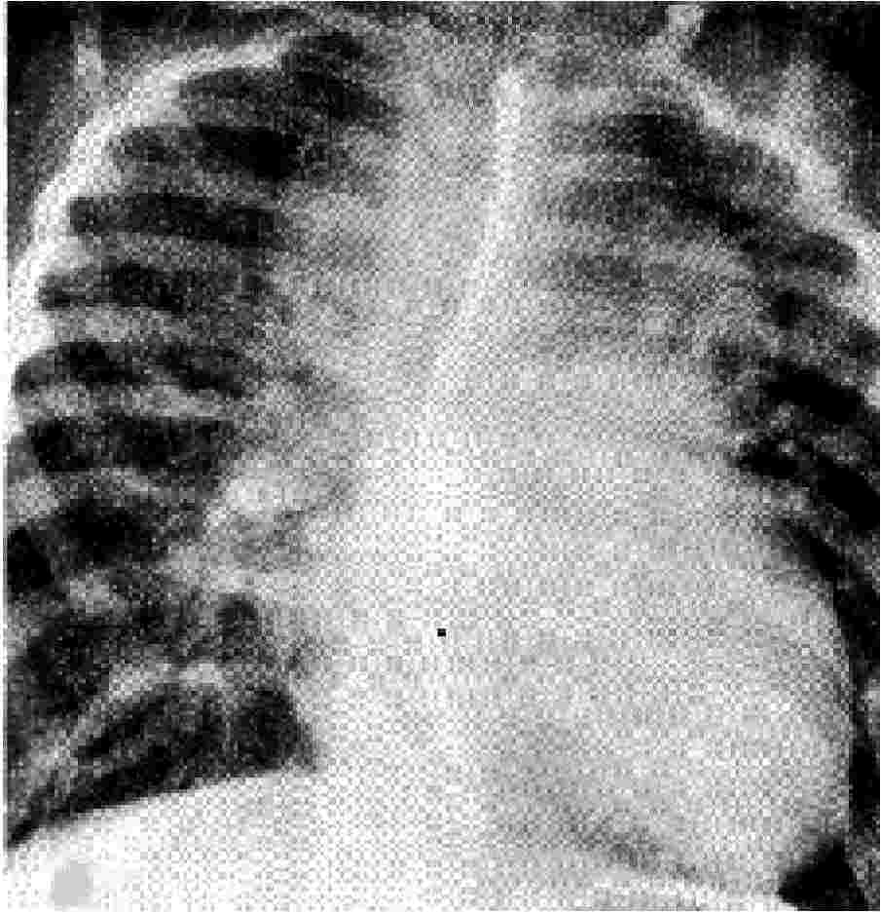

Slide 38
TAPVR₁
Snowman
50% type 1
50% snowman
venous connection at VV to SVC

Slide 39
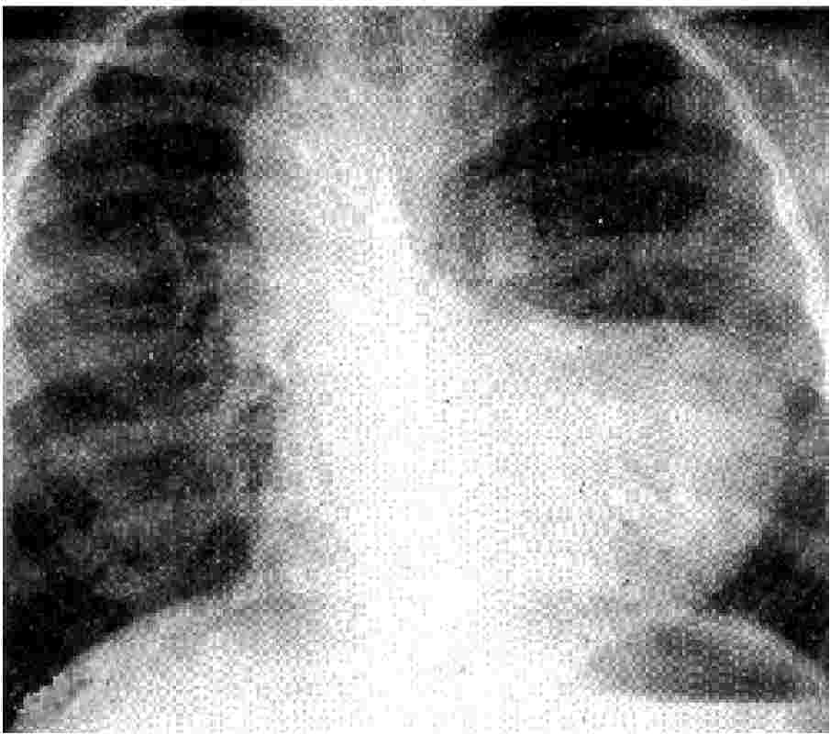

Slide 40
TOF
Boot shape
RVH lifting apex
loss of PA knob
Pulmonary atresia
Tricuspid atresia

Slide 41
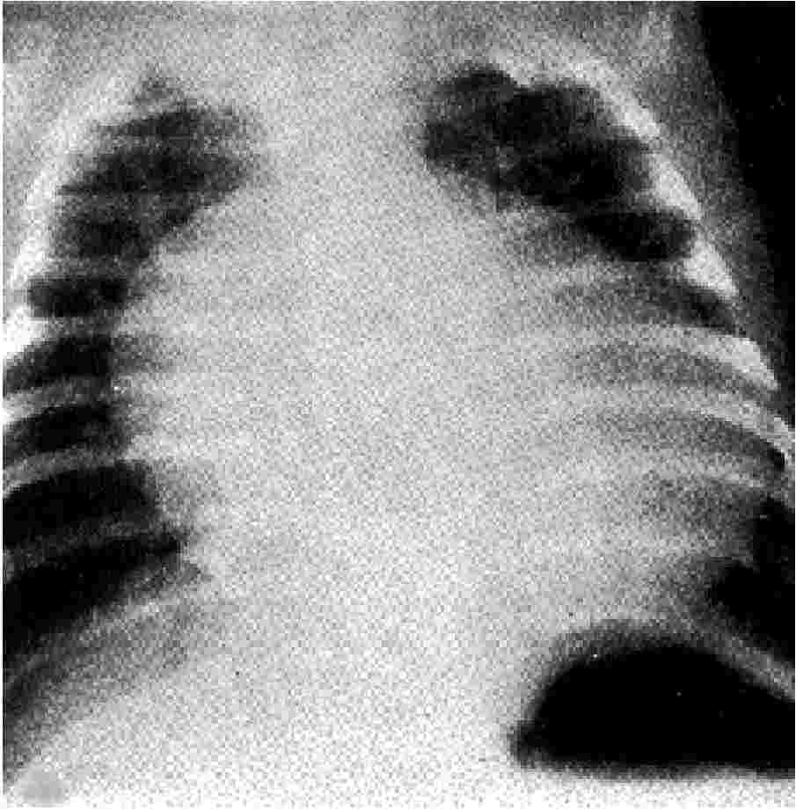

Slide 42
TGA
Egg on a string
alignment of PA and Ao narrows the mediastinum

Slide 43
List of 439 causes of Cyanosis
Aberrant subclavian artery abnormality - cyanosis
Accelerated silicosis - bluish skin
ACPS III - cyanosis
Acrocephalopolydactyly -- Cardiac Disease -- Ear, Skin and Lower Limb Defects - cyanosis
Acrocephalopolysyndactyly type III - cyanosis
Acrocyanosis - blue and cold hands
Acrodynia - cyanosis
Acrofacial dysostosis Rodriguez type - cyanotic heart disease
Acute respiratory distress syndrome, Infant - blue skin
Acute Silicosis - bluish skin
Adrenal hemorrhage, neonatal - cyanosis
Adult respiratory distress syndrome - cyanosis
Air embolism - cyanosis
Airway Obstruction - cyanosis
Al Gazali Aziz Salem syndrome - cyanotic heart disease
Alveolar capillary dysplasia - cyanosis

Slide 44
Alveolar hypoventilation
Alveolitis, extrinsic allergic - cyanosis with prolonged exposure
Anchovy poisoning (clupeotoxin) - cyanosis
Angineurotic oedema
Aniline dyes
Anophthalmia with pulmonary hypoplasia - cyanotic heart disease
Anoxemia - cyanosis
Anthracosis - cyanosis
Aortic arches defect - cyanosis
Apple seed poisoning - cyanosis
Apricot seed poisoning - cyanosis
Arterial occlusion
Arteriosclerotic occlusive disease
Asbestos conditions - Cyanosis
Asiatic porpoise poisoning - cyanosis
Asphyxia - cyanosis
Asphyxia neonatorum - cyanosis
Aspiration of foreign body
Asthma - cyanosis
Atrial myxoma, familial - blue skin
Atrial septal defect (ostium primum)
Autoimmune Myocarditis - Cyanosis
Beau's syndrome - bluish skin

Slide 45
Benign tracheal stenosis after tracheostomy
Berylliosis - cyanosis in chronic cases with prolonged exposure
Besnier-Boeck-Schaumann disease - cyanosis
Bindewald-Ulmer-Muller syndrome - cyanosis
Bird cherry seed poisoning - cyanosis
Bitter almond seed poisoning - cyanosis
Bonefish poisoning (clupeotoxin) - cyanosis
Bronchiectasis
Bronchiolitis - cyanosis
Bronchopulmonary dysplasia - episodic cyanosis
Brown snake poisoning - cyanosis
Carbamate insecticide poisoning - cyanosis
Cardiac failure
Cardiac malformation - cyanosis
Cast syndrome - cyanosis
Certain medications

Slide 46
Certain medications
Chemical pneumonia - cyanosis
Chemical poisoning -- 1,3-Dinitrobenzene - bluish skin
Chemical poisoning -- 2,4,6-Trinitrotoluene - cyanosis
Chemical poisoning -- 2,4-Dinitrotoluene - bluish skin
Chemical poisoning -- 4,4-Methylenebis - bluish skin
Chemical poisoning -- Acrylonitrile - cyanosis
Chemical poisoning -- Adiponitrile - bluish skin
Chemical poisoning -- Ammonium Nitrate - bluish skin
Chemical poisoning -- Aniline - cyanosis
Chemical poisoning -- Anisidine (o,p-Isomers) - bluish skin
Chemical poisoning -- Antifreeze - cyanosis
Chemical poisoning -- Antu - cyanosis
Chemical poisoning -- Azinphos-methyl - cyanosis
Chemical poisoning -- Carbaryl - cyanosis
Chemical poisoning -- Chlorate salts - cyanosis
Chemical poisoning -- Chlorobenzene - cyanosis
Chemical poisoning -- Demeton-S-methyl - cyanosis
Chemical poisoning -- Diazinon - cyanosis
Chemical poisoning -- Dichlorvos - cyanosis
Chemical poisoning -- Dicrotophos - cyanosis
Chemical poisoning -- Diethylene Glycol Monobutyl Ether - cyanosis
Chemical poisoning -- Dinitrocresol - cyanosis
Chemical poisoning -- Dioxathion - cyanosis
Chemical poisoning -- Disulfoton - cyanosis

Slide 47
Chemical poisoning -- Endosulfan - cyanosis
Chemical poisoning -- Epichlorohydrin - cyanosis
Chemical poisoning -- Ethion - cyanosis
Chemical poisoning -- Ethylene Glycol - cyanosis
Chemical poisoning -- Ethylene Glycol Dinitrate - bluish skin
Chemical poisoning -- Ethylene Oxide - cyanosis
Chemical poisoning -- Fensulfothion - cyanosis
Chemical poisoning -- Fenthion - cyanosis
Chemical poisoning -- Jet Fuel-4 - cyanosis
Chemical poisoning -- m-Anisidine - bluish skin
Chemical poisoning -- Malathion - cyanosis
Chemical poisoning -- Methidathion - cyanosis
Chemical poisoning -- Methiocarb - cyanosis
Chemical poisoning -- Methomyl - cyanosis
Chemical poisoning -- Mineral-Based Crankcase Oil - cyanosis
Chemical poisoning -- Mouth Wash - bluish skin
Chemical poisoning -- N,N-Dimethyl-P-Toluidine - blue skin
Chemical poisoning -- Nickel Carbonyl - blue skin
Chemical poisoning -- Nitrates - cyanosis
Chemical poisoning -- Nitric Acid - bluish skin
Chemical poisoning -- Nitrites - cyanosis
Chemical poisoning -- Nitrobenzene - blue skin
Chemical poisoning -- Nitroethane - bluish skin
Chemical poisoning -- Nitroglycerin - bluish skin

Slide 48
Chemical poisoning -- Nitrophenol Urea - blue skin
Chemical poisoning -- Nitrotoluene - bluish skin
Chemical poisoning -- o-Anisidine - bluish skin
Chemical poisoning -- p-Anisidine - bluish skin
Chemical poisoning -- Paraphenylenediamine - bluish skin
Chemical poisoning -- Parathion - cyanosis
Chemical poisoning -- Pepper Spray - cyanosis
Chemical poisoning -- Petroleum Distillates -- Naphtha - cyanosis
Chemical poisoning -- Phenol - cyanosis
Chemical poisoning -- Phosdrin - cyanosis
Chemical poisoning -- Profenofos - cyanosis
Chemical poisoning -- Propane - cyanosis
Chemical poisoning -- Propylene Glycol Dinitrate - bluish skin
Chemical poisoning -- Strychnine - cyanosis
Chemical poisoning -- Sulfur Dioxide - cyanosis
Chemical poisoning -- Terbufos - cyanosis
Chemical poisoning -- Tetraethyl Pyrophosphate - cyanosis
Chemical poisoning -- Thioglycolic Acid - cyanosis
Chemical poisoning -- Trichloroethylene - cyanosis
Cherry laurel seed poisoning - cyanosis
Cherry seed poisoning - cyanosis
Chokecherry seed poisoning - cyanosis

Slide 49
Choking
Cholesterol pneumonia - cyanosis
Chromosome 22, trisomy - cyanosis
Chromosome 22q11 Deletion Spectrum - Cyanosis
Chronic berylliosis - cyanosis
Chronic bronchitis - cyanosis
Chronic lower respiratory diseases - cyanosis
Chronic obstructive lung disease
Chronic obstructive pulmonary disease
Chronic pneumonitis of infancy - cyanosis
Chronic respiratory conditions - cyanosis
Circulatory disorder - cyanosis
Circulatory system conditions - cyanosis
Coal worker's pneumoconiosis - cyanosis
Codeine overdose - bluish skin
Cold exposure
Cold weather
Congenital arteriovenous shunt - cyanosis
Congenital cardiovascular malformations - cyanosis
Congenital diaphragmatic hernia - cyanosis
Congenital heart defects - blue skin
Congenital heart disease
Congenital heart septum defect - bluish skin

Slide 50
Congenital methaemoglobinaemia
Congenital mitral malformation - cyanosis
Congenital tracheal stenosis - cyanotic episodes
Conotruncal heart malformations - cyanosis
Convulsions, benign familial infantile, 1 - cyanosis
Convulsions, benign familial infantile, 3 - cyanosis
Convulsions, benign familial infantile, 4 - cyanosis
COPD - blue nails
Cor biloculare - cyanosis
Cor Triatriatum - cyanosis
Coral snake poisoning - cyanosis
Coronary arteries -- congenital malformation - cyanosis
Croup - cyanosis
Cutis Marmorata Telangiectatica Congenita - blue marbled skin appearance
Cyanosis
Cyanotic congenital heart disease
Darvocet overdose - bluish skin
Decreased oxygen saturation - cyanosis
Deletion 22q11 - cyanosis
Demerol overdose - bluish skin
Diaphragmatic hernia, congenital - blue skin
Diaphragmatic paralysis - blue fingers
Diffuse lung disease

Slide 51
Dilaudid overdose - bluish skin
Diphosphoglycerate mutase deficiency of erythrocyte - cyanosis
Double outlet -- right ventricle II - cyanosis
Double outlet -- right ventricle IV - cyanosis
Double outlet right ventricle - bluish skin
Drowning - cyanosis
Drug overdose
Ductus arteriosus, patent reversed flow - cyanosis
Duodenal atresia tetralogy of Fallot - cyanosis
Ebstein's anomaly - cyanosis
Eisenmenger Syndrome - cyanosis
Eisenmenger's syndrome
Emphysema - blue skin
Emphysema, congenital lobar - cyanosis in severe forms
Epiglotitis - cyanosis
Esophageal Atresia and/or Tracheoesophageal Fistula - cyanosis
Esophageal atresia with tracheoesophageal fistula - cyanosis
Eucalyptus Oil poisoning - cyanosis
Fallot syndrome - cyanosis
Fallot's tetralogy
Familial emphysema - blue skin
Familial interstitial fibrosis - cyanosis
Farmer's lung - cyanosis
Fibrosing alveolitis - cyanosis
Grand mal epilepsy - Cyanosis
Grand mal seizures - cyanosis

Slide 52
Haemoglobin M
Hamman-Rich syndrome - cyanosis
Heart attack - cyanosis
Heart failure
Hemangiomatosis, familial pulmonary capillary - bluish skin
Heroin overdose - bluish skin
Herring poisoning (clupeotoxin) - cyanosis
HMG-CoA lyase deficiency - cyanosis
Hydrocodone overdose - bluish skin
Hydrogen sulfide
Hyperekplexia and epilepsy - cyanosis
Iatrogenic pneumothorax - Cyanosis
Idiopathic diffuse interstitial fibrosis - cyanosis
Idiopathic pulmonary hypertension - cyanosis
Idiopathic subglottic tracheal stenosis - cyanosis
Infantile apnea - cyanosis
Inhaled foreign body
Insect sting allergies - Cyanosis
Iron poisoning - Cyanosis
Isaacs syndrome - cyanotic episodes
Ischemic heart disease

Slide 53
Ivemark Syndrome - cyanosis
Jervell and Lange-Nielsen Syndrome - cyanosis
Kugel-Stoloff syndrome - cyanosis
Lantana poisoning - cyanosis
Laryngeal cleft - cyanosis
Laryngeal oedema
Larynx obstruction
Left heart failure
Left ventricular failure
Legionella adelaidensis infection - cyanosis
Legionella anisa infection - cyanosis
Legionella beliardensis infection - cyanosis
Legionella birminghamensis infection - cyanosis
Legionella bozemanii infection - cyanosis
Legionella bruneiensis infection - cyanosis
Legionella brunensis infection - cyanosis
Legionella busanensis infection - cyanosis
Legionella cherrii infection - cyanosis
Legionella cincinnatiensis infection - cyanosis
Legionella donaldsonii infection - cyanosis
Legionella donaldsonil infection - cyanosis
Legionella drancourtii infection - cyanosis
Legionella drozanskii infection - cyanosis
Legionella dumofii infection - cyanosis
Legionella erythra infection - cyanosis
Legionella fairfieldensis infection - cyanosis

Slide 54
Legionella tauriensis infection - cyanosis
Legionella tusconensis infection - cyanosis
Legionella wadsorthii infection - cyanosis
Legionella wadsworthii infection - cyanosis
Legionella waltersii infection - cyanosis
Legionella worsliensis infection - cyanosis
Legionella yabuuchiae infection - cyanosis
Lethal chondrodysplasia, Moerman type - cyanotic heart disease
Levotransposition of the great arteries - cyanosis
Lichen planus - blue areas inside cheeks
Limb transversal defect -- cardiac anomaly - cyanotic heart disease
Lissencephaly - cyanotic infant
Local vasoconstriction
Long-standing hypopnoea
Long-standing sleep apnoea
Lortab overdose - bluish skin
Lung cancer
Lung diseases - causing cyanosis include:
Lung disorders
Lung trauma
Lupus - cyanosis
Lymphangiomatosis, pulmonary - cyanosis
Marie-Bamberg syndrome - cyanotic nails
Meadows syndrome - cyanosis
Meconium aspiration syndrome - cyanosis
Melioidosis - cyanosis
Mendelson syndrome - cyanosis

Slide 55
Methadone overdose - bluish skin
Methaemoglobinaemia
Methaemoglobinemia - cyanosis
Methahemoglobinemia - blue nails
Methemoglobinemia
Methemoglobinemia, beta-globin type - bluish area under fingernails
Microcephalic osteodysplastic primordial dwarfism, type 1 - cyanotic attacks
Microphthalmia syndromic, type 9 - cyanotic heart disease
Mitral atresia - blue nail beds
Morphine overdose - bluish skin
Mountain sickness - cyanosis
Neonatal Respiratory Distress Syndrome - cyanosis
Neonatal sepsis - cyanosis
Neuromyotonia - Cyanotic episodes
Non cardiogenic pulmonary oedema - cyanosis
Nosocomial pneumonia - cyanosis
Organophosphate insecticide poisoning - cyanosis
Osler-Vaquez disease - cyanosis
Partial atrioventricular canal - bluish skin
Patent foramen ovale
Peach seed poisoning - cyanosis
Penetrating chest wound - cyanosis
Penetrating chest wounds - cyanosis
Peripheral arterial occlusion

Slide 56
Pickwickian syndrome
Pierre Robin's sequence - cyanosis
Plant poisoning -- Amygdalin - bluish skin
Plant poisoning -- Cyanogenic glycoside - bluish skin
Plant poisoning -- Hydroquinone - bluish skin
Plant poisoning -- Lantadene - bluish skin
Pneumoconiosis - cyanosis
Pneumonia - cyanosis
Pneumonia caused by serotype O11 Pseudomonas Aeruginosa - bluish skin
Pneumonia, Aspiration - bluish skin
Pneumonia, Bacterial - bluish skin
Pneumonia, Staphylococcal - bluish skin
Pneumothorax
Polycythaemia rubra vera
Polycythemia rubra - cyanosis
Primary pulmonary hypertension - cyanosis
Primary tracheal tumor
Pseudohypoaldosteronism type 1 - cyanotic attacks upon exposure to increased temperature
Pseudohypoaldosteronism type 1, autosomal dominant - cyanotic attacks upon exposure to increased temperature
Pseudohypoaldosteronism type 1, autosomal recessive - cyanotic attacks upon exposure to increased temperature

Slide 57
Pulmonary Alveolar Proteinosis - cyanosis
Pulmonary arterio-veinous aneurysm - cyanosis
Pulmonary arteriovenous fistula - cyanosis
Pulmonary arteriovenous malformation - blue skin
Pulmonary artery coming from the aorta - cyanosis
Pulmonary atresia
Pulmonary atresia -- intact ventricular septum - blue skin
Pulmonary atresia with ventricular septal defect - blue skin
Pulmonary cystic lymphangiectasis - cyanosis
Pulmonary edema - cyanosis
Pulmonary edema of mountaineers - cyanosis
Pulmonary embolism - cyanosis
Pulmonary infections related to AIDS - Cyanosis
Pulmonary lymphangiectasia, congenital - cyanosis
Pulmonary valve stenosis
Pulmonary venous return anomaly - cyanosis
Raynaud's disease
Raynaud's phenomenon - Cyanosis (blueness)
Respiratory arrest - cyanosis
Respiratory depression - cyanosis
Respiratory disease
Respiratory distress syndrome, infant - cyanosis
Respiratory failure
Respiratory muscle paralysis - blue fingers
Respiratory paralysis - blue fingers

Slide 58
Right to left cardiac shunt
Right ventricle hypoplasia - cyanosis
Sakati syndrome - cyanosis
Sardine poisoning (clupeotoxin) - cyanosis
Sea snake poisoning - cyanosis
See also causes of cyanosis, blue skin, dark skin, purple skin, or skin color changes
Sepsis - Cyanosis
Severe asthma - cyanosis
Severe heart problems - cyanosis
Severe shock
Shaken Baby Syndrome - bluish skin
Shallow Breathing - cyanosis
Shaver's disease - cyanosis
Shock - cyanosis
Short stature webbed neck heart disease - cyanotic heart disease
Shprintzen syndorme - cyanosis
Silicosiderosis - bluish skin
Silicosis - bluish skin
Slickhead poisoning (clupeotoxin) - cyanosis
Sneddon Syndrome - cyanosis
Spontaneous pneumothorax, familial type - bluish skin
Streptococcal Group B invasive disease - blue skin
Subpulmonary stenosis - bluish skin

Slide 59
Suffocation - Cyanosis
Sulfhemoglobinemia
Sulphaemoglobinaemia
Superior vena cava syndrome - cyanosis of face
Superior vena caval obstruction
Surfactant Metabolism Dysfunction - cyanosis
Surfactant Metabolism Dysfunction, Pulmonary, 1 - cyanosis
Surfactant Metabolism Dysfunction, Pulmonary, 2 - cyanosis
Surfactant Metabolism Dysfunction, Pulmonary, 3 - cyanosis
Tarpon poisoning (clupeotoxin) - cyanosis
Taussig Bing syndrome - cyanosis
Tetralogy of Fallot - Cyanosis
Thyroid carcinoma
Tonic seizure - cyanosis
Tonic-Clonic seizure - cyanosis
Tracheal agenesis without tracheoesophageal fistula - cyanosis
Tracheal stenosis syndrome - cyanotic episodes
Tracheoesophageal fistula without esophageal atresia - cyanosis with feeding
Transposition of great arteries
Tricuspid atresia
Tricuspid valve stenosis
Truncus Arteriosus - blue skin
Twisted atrioventricular connections - cyanosis
Type 1 Tracheal agenesis without tracheoesophageal fistula - cyanosis
Type 2 Tracheal agenesis without tracheoesophageal fistula - cyanosis
Type 3 Tracheal agenesis without tracheoesophageal fistula - cyanosis
Unilateral pulmonary agenesis - cyanosis

Slide 60
Vaquez disease - cyanosis
Vascular malposition - Cyanosis
Vein of Galen aneurysm - Cyanosis
Velocardiofacial syndrome - Cyanosis
Ventricular septal defect - Cyanosis
Ventriculo-arterial discordance, isolated - Cyanosis
Vicodin overdose - bluish skin
VLCAD deficiency - Cyanosis
Waterhouse-Friderichsen syndrome - Cyanosis
Waterhouse-Friederichsen syndrome - cyanosis
Weinstein Kliman Scully syndrome - Cyanosis
Western equine encephalitis - Cyanosis
Whooping Cough - Blue or purple (cyanosis)
Wild cherry seed poisoning - cyanosis

