Slide 1
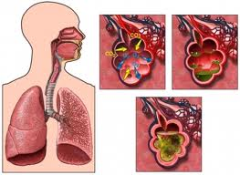
A CASE PRESENTATION ON VIRAL PNEUMONIA
PRESENTED BY:-
SR. SARASWATI ROY
CONTROLLER NCS
MSHK

Slide 2
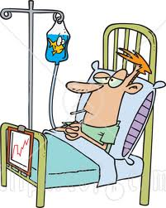
Presentation
A 34 years old lady accompanied by
Her family arrived at the Emergency of
Medica Hospitals complaining of Fever,
Headache, generalized body ache &
Dry cough for last 7 days.
She got hospitalized and was evaluated
for fever in the general ward.

Slide 3
PROVISIONAL DIAGNOSIS WAS THOUGHT TO BE:-
VIRAL PNEUMONIA

Slide 4
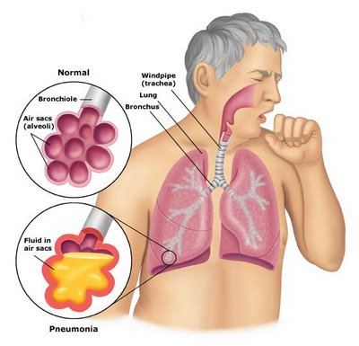
Auto-immune diseases
BACTERIAL
(Most common)
DRUGS
V
I
R
A
L
(2)
F
UNGA
L
Pneumonia is an inflammatory condition of the Lungs,
affecting mainly the air- sacs or Alveoli
PNEUMONIA AND ITS TYPES

Slide 5
Alteration in net bacterial/
Viral lung resistance
Containment of the bacteria/ virus within the lobes thereby causing consolidation of leucocytes/ fibrin within the affected area
Acute inflammation occurs that causes water & plasma proteins go to the lower lobes
Stage of Congestion:-
Engorgement of alveolar spaces with fluid and hemorrhagic exudates which causes spread of pathogens through the lobe
PATHOPHYSIOLOGY
RBC’s, fibrin & poly-morpho nuclear leukocytes infiltrate the alveoli
Stage of Red Hepatization:-
Coagulation of the red exudates occurs and the affected lung appears red

Slide 6
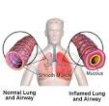
Stage of Grey Hepatization:-
The decrease in RBC count is replaced by neutrophils which infiltrates the alveoli making the Lung tissue solid & grayish in color
PATHOPHYSIOLOGY
PNEUMONIA

Slide 7
RISK FACTORS

Slide 8
CLINICAL MANIFESTATIONS OF PNEUMONIA
Fever
Rapid or difficult breathing
Non- productive Cough
Loss of appetite
Chills
Wheezing
(more common in Viral ones)
Headache
Myalgia
Running nose
Fatigue
Sharp or stabbing chest pain which increases on breathing
Excessive sweating or clammy skin

Slide 9
SYMPTOMS (in my patient)
Her symptoms started 7 days ago with mild fever , cough, headache & sore throat for which she received antipyretic, antihistaminic and cough syrup after consulting the local physician.
After initial improvement, she had a worsening of symptoms starting 3 days ago with high fever, generalized body ache , so she decided to come to the hospital…

Slide 10
SYMPTOMS
She was getting treated for her high fever in the General Ward.
She was Malaria, Dengue negative but Total Count went down to 3400thou/cm3.
On 12.11.2012, she had sudden SOB
(RR >40breaths/min) fever(101.8deg F) and respiratory acidosis in spite of all ongoing treatments.
Her condition deteriorated and she was rushed to CCU-1

Slide 11
PAST CLINICAL HISTORY:-
No surgery or hospitalization ever before.
She had fever one month back.
FAMILY HISTORY:- Nothing significant.
PRESENT MEDICAL HISTORY:-
Fever, head ache and generalized body ache with dry cough since last 7 days.

Slide 12
EXAMINATION
Anxious, Confused
Temperature :- 101.8deg F
Blood pressure :- 148/90 mm of Hg
Pulse rate :- 128 bpm
Respiratory Rate :- 44 per minute
Clinical signs of right upper zone consolidation
and bilateral wheeze
No cyanosis
Pedal edema :- ++ present
Jugular venous distension :- Present

Slide 13
Diagnostic tests
Various Blood investigations
Sputum: Gram staining and Culture.
Blood & Urine cultures.
Thoraco-centesis.
Chest X-Rays

Slide 14
SGOT-420
SGPT-247
CRP- 74
(9.11.12)
Hb- 8.4
TC- 6,600
(18.11.12)
Hb-5.9
(15.11.12)
SGPT-112
SGOT-134
(16.11.12)
Hb-8.8
TC- 3,400
(10.11.12)
Blood picture
Hb- 7.4
SGOT- 453
SGPT- 270
(14.11.12)
Hb- 9.0
INR-1.70
CRP- 196.8
TRIGLYCERIDES-514
SGPT-270, SGOT-453
(12.11.12)
Hb-7.8
SGOT- 427
SGPT- 236
(13.11.12)

Slide 15
BLOOD C/S-
No Growth
(10.11.12)
URINE C/S-
No Growth
(12.11.12)
CULTURE REPORTS
SPUTUM FOR GRAM STAIN-
Few Gram Negative Bacilli & Gram Positive Cocci seen.
(14.11.12)
PLEURAL FLUID C/S-
Few Pus cells, No growth
BLOOD C/S -
(From Rt. & Lt. Brachial vein)
No growth
(13.11.12)

Slide 16
CHEST X-RAY
REVEALED
B/L LUNG OPACITY
B/L PLEURAL EFFUSION

Slide 17
WHAT IS THE VALUE OF CHEST X-RAY IN VIRAL PNEUMONIA???
Pattern
Establish Dx
Co-existing conditions:-
Bronchitis, Bronchial Obstruction, Abscess
Evaluation of severity-
Multilobar or bilateral,
Patchy, Pleural Effusion

Slide 18
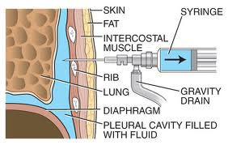
She developed shock and her chest X-Ray revealed B/L Pleural Effusion ;
so, Therapeutic Thoraco-centesis was done on 13.11.12

Slide 19
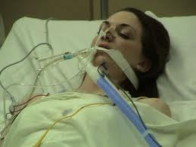
She was being tried to get managed with NIV but was finally put on
mechanical ventilation due to Desaturation, Severe Hypoxaemia
with metabolic acidosis on 14.11.12.
Along with Ventilation , Methyl Prednisolone therapy was started, to
which she responded & showed improvement.

Slide 20
DIET
ANTI-PYRETICS
FLUID
ANTIBIOTICS
STEROIDS
SKILLED
NURSING CARE
THERAPY
HEMODYNAMIC MONITORING
REGULAR INVESTIGATIONS
O2
THERAPY
PACKED RBC
TRANSFUSION
CHEST PHYSIO.
MECH.
VENTILATION

Slide 21
Anemia R/t disease progression
Relevant
Nursing Diagnosis
Self care deficit R/t Disease condition and Bed-ridden Status
Anxiety R/t
Disease condition
Impaired Nutritional status R/t disease condition
Impaired gas exchange R/t Disease process
Risk of infection R/t disease process,
Invasive lines and
Low TC, Hb level
Ineffective airway clearance & chances of E.T Tube Blockage

Slide 22
NURSING CARE PLAN
Severe Shortness of
Breath
Tachycardia,
Tachypnoea
Restless,
Confusion
SPO2
IMPAIRED GAS EXCHANGE R/T POOR LUNG COMPLIANCE
Propped –up position
Oxygen therapy
Nebulisation therapy
Hemodynamic monitoring
Mech. Ventilation
Auscultation
Suctioning
ABG analysis
Chest Physio & Spirometry
Antibiotics & Diuretics
Strict I/O chart

Slide 23
NURSING CARE PLAN
Hemoglobin-
5.9gm / dl
Pallor ++
Respiratory
Distress
Anemia R/T
Disease Progression
Complete Bed rest
Hemodynamic monitoring
Blood transfusion
Diet
Blood for Hb%

Slide 24
NURSING CARE PLAN
Anxious ,
Restless
Depressed
Lots of queries
Anxiety R/T Fear of Unknown Outcome
Re-assurance
Counseling
Good IPR
Proper explanation
Participation in care

Slide 25
NURSING CARE PLAN
Fever
Presence of Effusion
Congested Lung
High risk of infection R/T
Disease condition
Proper Hand Washing
Maintained Aseptic technique
Monitored temperature
Antibiotics & Steroids given
Blood for TC, DC, ESR checked
Blood , Urine & Sputum C/S checked
High Protein diet given
Hygiene maintained

Slide 26
NURSING CARE PLAN
Dull & Weak
Appearance
SOB
Fatigue
Activity Intolerance & Self Care Deficit R/T Disease condition
Comfortable position provided
ROM exercise provided
Sponge bath, Back care provided
Position changed
Encouraged activity as per symptom tolerance

Slide 27
MY CLIENT’S COURSE OF EVENTS
Admitted on 9.11.12 with fever, headache and generalized body ache in G.W.
Put on antipyretics and antibiotics.
She had sudden SOB on 12.11.12
Tried with NIV till afternoon of 14.11.12 but condition deteriorated.
She started desaturating and was hypoxemic, so was put on Mechanical
Ventilation on 14.11.12.
Steroid therapy started to which she responded slowly but her condition improved.
Developed anemia and was treated with PRBC transfusion.
She got extubated on 16.11.12 & showed improvement.
Systemic Lupus Erythema was suspected for her & so necessary investigations were carried out.
She was referred to a clinical Immunologist Rheumatologist.
Hydroquinolones started on & steroids got tapered.
She was kept on follow-up care & got shifted to HDU.
She got well & got discharge on 24.11.12.

Slide 28
CONCLUSION
Ms. Bose got admitted in M.S.H.K on 9.11.12 with the hope that
“She will be able to take breath without any effort in his day to day activity and ultimately, the total team of Medica with the help of advanced life saving gadgets makes her dream a real one.”
She got discharged on 24.11.12 without any evident of complication….

Slide 29
THANKS A LOT!

