Slide 1

WORLD tb Day
2014
24 march
Reach the three million - A TB test, treatment and cure for all
Dr.T.V.Rao MD

Slide 2


Slide 3
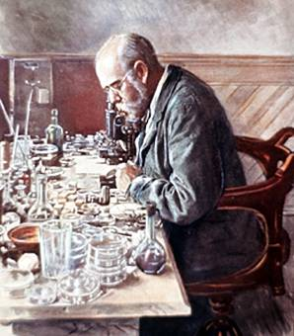
March 24 commemorates with ……
It commemorates the day in 1882 when Dr Robert Koch astounded the scientific community by announcing that he had discovered the cause of tuberculosis, the TB bacillus. At the time of Koch's announcement in Berlin, TB was raging through Europe and the Americas, causing the death of one out of every seven people. Koch's discovery opened the way towards diagnosing and curing TB.

Slide 4
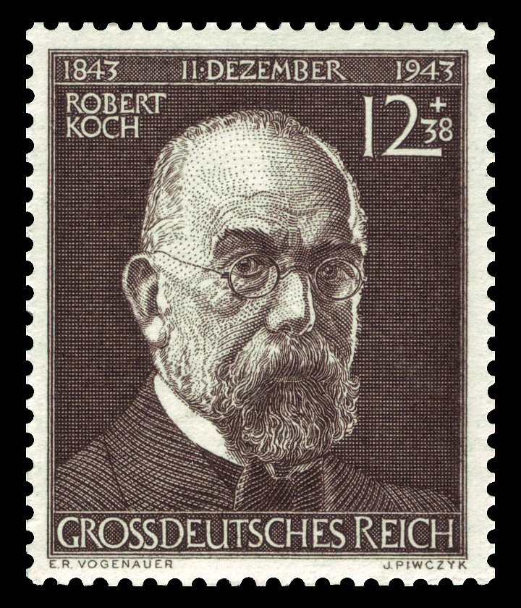
History of world tb day
In 1982, on the one-hundredth anniversary of Robert Koch's presentation, the International Union Against Tuberculosis and Lung Disease (IUATLD) proposed that March 24 be proclaimed an official World TB Day. This was part of a year-long centennial effort by the IUATLD and the World Health Organization (WHO) under the theme “Defeat TB: Now and Forever.

Slide 5
The theme will be:
2014
Reach the three million
As highlighted in the WHO 2013 Global TB Report, three million people are missed every year by health systems. This has been the case for six years now.
The Partnership believes that no one should be left behind in the fight against TB if we want to move towards a ZERO TB deaths world.

Slide 6
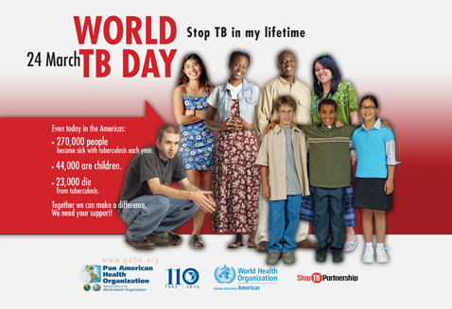
World TB Day 2014
For World TB Day 2014, partners will call for a global effort to find, treat and cure all people with TB and accelerate progress towards the bold goals we expect to see in TB strategies post-2015 and a world with Zero TB deaths, stigma and infections.

Slide 7
World TB Day in India
World Tuberculosis Day is celebrated every year by the people all across the world at international level on 24th of March. It is celebrated to raise the common public awareness about the epidemic disease of tuberculosis as well as get their efforts in order to totally eradicate this disease. As around 1.7 million of the people are dying of this disease every year. 24th of March has been established to commemorate the tuberculosis day by all at one place in order to get some solution to eradicate it from the world.

Slide 8
The "missed" three million
TB is curable, but our current efforts to find, treat and cure everyone who gets ill with the disease are not sufficient.
Of the nine million people a year who get sick with TB, a third of them are "missed" by public health systems.
Many of these three million people live in the world's poorest, most vulnerable communities and include groups such as migrants, miners, drug users and sex workers.

Slide 9
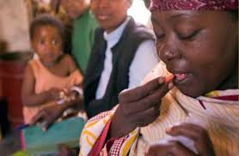
OUR Aim everyone to access to treatment
Make believe and work with dedication that no one should be left behind in the fight against TB. This World TB Day, we call for a global effort to find, treat and cure the three million and accelerate progress towards zero TB deaths, infections, suffering and stigma.

Slide 10
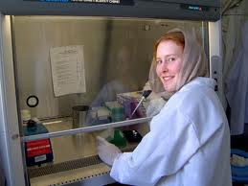
What are our goals
We must invest in basic research and research and development for new tools - diagnostics, drugs and vaccines - in order to reach people faster, treat them more quickly and ultimately prevent them from becoming ill with TB.

Slide 11
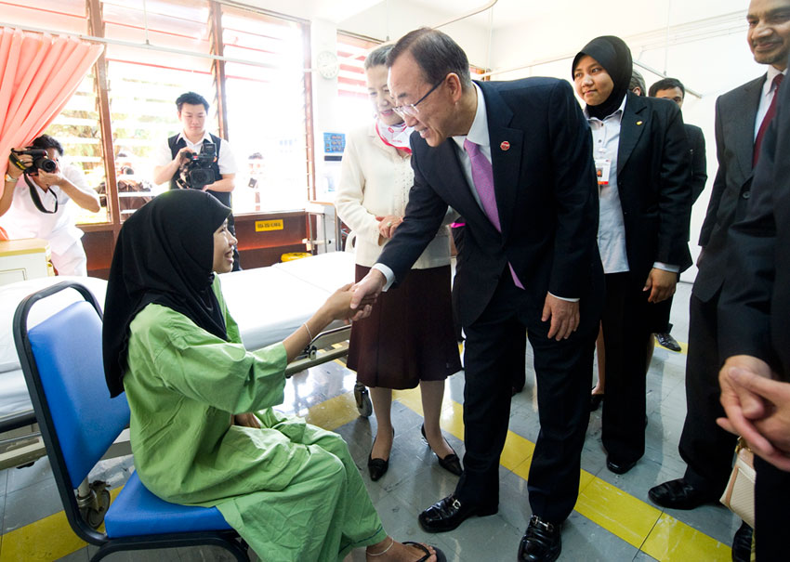
Many will call on the infected people
This World TB Day, people all over the world, from TB programme managers to frontline health care providers will make a call to Reach the three million and ensure that everyone suffering from TB has access to adequate TB care, including diagnosis, treatment and cure.

Slide 12
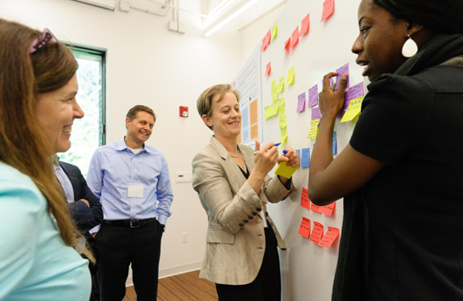
World tb day 2014 targets many groups of infected ..
This year’s World TB Day theme encourages local and state TB programs to reach out to their communities to raise awareness about TB. We don’t have to fight TB alone; we should partner with others who are also caring for those most at risk for TB such as people with HIV infection or diabetes, and the homeless. Everyone has a role in ensuring that one day TB will be eliminated. CDC and our partners are committed to a world free of TB.

Slide 13
revised National Tuberculosis Control Programme (RNTCP) – Guidelines for TB Control in India
RNTCP India was implemented in 1997 based on the WHO recommended strategy of Directly Observed Treatment, Short Course (DOTS). The diagnosis is made primarily by sputum microscopy, which is made available free of cost to patients at designated microscopy centres. Treatment is provided under direct observation by a DOT Provider at the DOTS centre near patients’ home. Enhanced supervision is ensured through a ‘Tuberculosis Unit’, a sub-district level unit comprising of specialized staff. The programme has detailed guidelines for Programme Management, Programmatic Management of Drug Resistant Tuberculosis (PMDT), TB-HIV, Paediatric TB, Supervision and Monitoring, Public Private Mix (PPM), Airborne Infection Control.

Slide 14

Follow the rntcp guidelines
RNTCP ( Revised National Tuberculosis Control Programme) is an application of WHO recommended strategy of DOTS in India. It is largely based on the research done at National Tuberculosis Institute, Bangalore and Tuberculosis Research Centre, Chennai.

Slide 15
Objectives of rntcp
Objectives:
1- Detecting at least 70% of sputum positive tuberculosis patients in the community.
2- Curing at least 85% of the newly detected sputum positive cases.
Components of DOTS (Directly observed treatment strategy)
1- Political and administrative commitment at all levels.
2- Diagnosis through sputum microscopy
3- Uninterrupted supply of short course chemotherapy drugs.
4- Direct observation of drug intake ( DOTS)
5- Systematic monitoring, evaluation and supervision at all levels.

Slide 16
Do not forget
As per the Government regulations Tuberculosis is a Notifiable disease and it is the Responsibility of every Physician treating the Tuberculosis patients

Slide 17


Everyone is concerned to stop TB
ARE you

Slide 18
Programme Designed by Dr.T.V.Rao MD for Medial and Health care workers in Developing Countries from WHO / CDC and national guidelines
Email
doctortvrao@gmail.com

