Slide 1
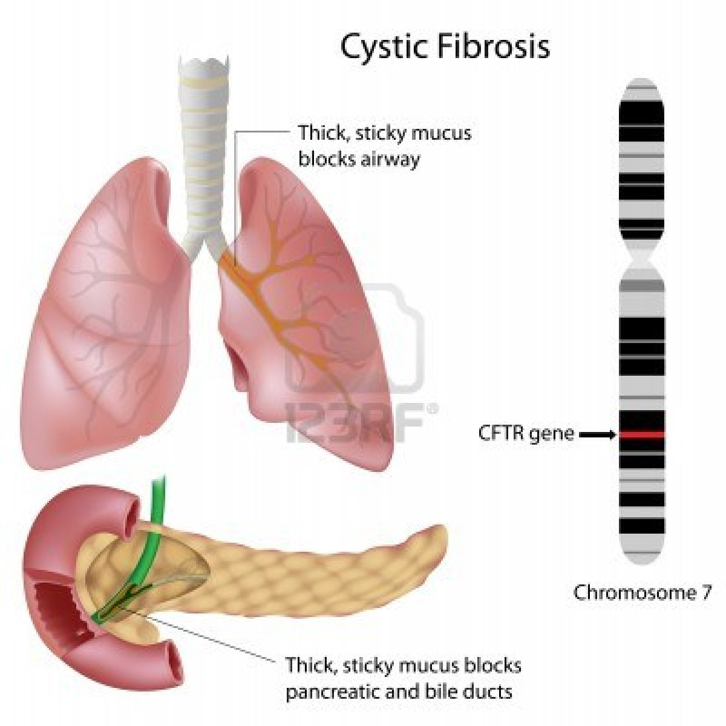
Cystic fibrosis
Parul Shrestha

Slide 2
Background
Cystic fibrosis, also known as CF is a common disease that are inherited and mostly found in young population.
It is an autosomal recessive disorder which means that a person must receive two altered CF genes in order to get this condition.
It is a life-threatening disorder that causes severe damage to the lungs and digestive system.
A person with this condition produces thick, sticky mucus, which clogs the lungs, causes repeated infection and difficulty breathing.

Slide 3
Contd…
It is most common in Caucasian, but also occurs in Hispanics, African-Americans and some Native Americans.
It is rare in people of Asian and Middle Eastern origin.
Millions of Americans carry the defective CF gene, but do not have any symptoms. That's because a person with CF must inherit two defective CF genes -- one from each parent.
An estimated 1 in 29 Caucasian Americans have the CF gene
The average life span for people with this disease is approximately 37 years, which is a much more than what it used to be

Slide 4
Symptoms
The signs and symptoms of the disease will vary depending upon its severity.
In some case, symptoms are seen as early as infancy; in other cases a person does not experience anything until adulthood.
Symptoms in newborns
Delayed growth
Failure to normal weight gain during childhood
No bowel movements in first 24 to 48 hours of life
Salty-tasting skin

Slide 5
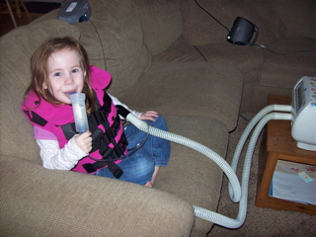
Symptoms
Respiratory Symptoms
Cough that produces thick sputum and mucus
Wheezing and Breathlessness
Repeated lung infections
A stuffy nose
Digestive Symptoms
Foul-smelling, greasy stools
Poor weight gain and growth
Intestinal blockage and Severe constipation

Slide 6
Causes
Cystic Fibrosis is caused by homozygosity for an autosomal recessive mutation located on the long arm of chromosome 7 at position 7q31.2-q31.3.
The most common mutation, ΔF508, is a deletion of three nucleotide or three consecutive base pairs in the gene.
These results in the loss of one amino acid called phenylalanine at position 508 since each amino acid in a protein is specified by three base pairs in the sequence
Researches have indicated that the 1,480-amino acid cystic fibrosis protein is associated with cell membrane.
The ΔF508 mutation affects the adenosine triphosphate (ATP) binding, nucleotide-binding fold (NBF) area of the protein

Slide 7
Causes
When the amino acid sequences of the Cystic Fibrosis conductance Transmembrane Regulator, CFTR genes were compared with other proteins, CFTR protein was found to be related to proteins involved in active transportation of materials across cell membrane.
When there is no mutation, the CFTR gene sits in the membrane of cell and regulates the movement of chloride ion in and out of that cell.
In case of mutation, sometimes the CFTR gene does not allow the chloride ions to pass through it
In other cases, the CFTR gene is missing completely so the movement of the ions through the cell membrane is hindered.

Slide 8
Causes
A child receives one chromosome 7 from his father and another from his mother.
If both the chromosomes received have defected CFTR gene, the child will develop CF.
CF develops only when a person receives two defective genes, which makes it recessive disorder.
When father and mother both carry defected CFTR, the child will have 1 in 4 chance of getting infected with this disease.

Slide 9
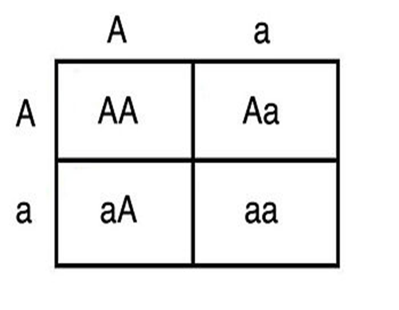
Punnet Square

Slide 10
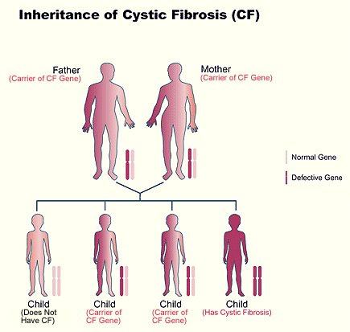

Slide 11
Test and Diagnosis
New born screening - a blood sample is checked for higher than normal levels of a chemical released by the pancreas.
Sweat test- A high salt level in the patient's sweat is a sign of the disease
Genetic test- DNA samples from blood or saliva can be checked for specific defects on the gene
Sputum culture. Your spit (sputum) is analyzed for bacteria.
Imaging tests. Damage to your lungs or intestines can be monitored with X-rays, CT scans and MRI
Lung function tests. These tests measure the size of your lungs, how much air you can breathe in and out

Slide 12
Treatments and Drugs
Antibiotics to treat and prevent lung infections
Mucus-thinning drugs to help you cough up the mucus, which improves lung function
Bronchodilators to help keep your airways open by relaxing the muscles around your bronchial tubes
Oral pancreatic enzymes to help your digestive tract absorb nutrients.
Chest Physical Therapy
Pulmonary rehabilitation
Surgical and other procedures like Nasal polyps removal, oxygen therapy, lung transplant, bowel surgery

Slide 13
Research
CF hasn’t been fully curable, many researches are taking place in the hope that one day human beings will be able to win over this disease completely
A research was done by Sorio et al. to develop a blood test for CF.
The alveolar macrophages in human beings have been found to express functional CFTR genes .So, the researchers aimed to confirm this finding and do further experiment in this matter by demonstrating the expression of processed CFTR gene in monocytes.
The researchers planned to come up with a functional procedure using monocytes derived from blood

Slide 14
Research
The monocyte derived from the people without CF showed CFTR localized in cell membrane with PKA phosphorylation whereas there was no detection or short form detection in monocytes obtained from CF patient
When CFTR agonist was administered, it generated membrane depolarization in monocytes derived from people without CF but it failed to do so in monocytes of patient with CF
The result of the research showed that the CFTR gene can be found and is functional in the monocyte.
The research proved that any activity related to CFTR could be performed in 5 ml of blood and formulated an index which was useful for diagnostic purpose and research in future

Slide 15

Experience

Slide 16
References
Collins, F.S. (2006) Cystic fibrosis: Molecular Biology and Therapeutic Implication. Science. 256(5058), 774-779.
Russell, P.J.; iGenetics: A Molecular Approach , 3rd edition. San Francisco, CA: Pearson Education; 2010, p. 71.
Murphy, S.V., Lim, R., Cholewa,M., Gros, M.L., Jonge, M.D., (2012) Human Amnion Epithelial Cells Induced to Express Functional Cystic Fibrosis Transmembrane Conductance Regulator. Plos One . 7(9). 1-8.
Sorio,C., Buffeli, M., Angiari C., Ettorre, M.,Johansson, J.,(2011) Defective CFTR expression and function are detectable in blood monocyte: Development of New Blood Test for Cystic Fibrosis. Plos One. 6(7). 1-13.
Cystic Fibrosis, Fibrosis, Hospital, Medication (2013). Retrieved March 29th, 2013 from
http://www.cysticfibrosis.net/history-cystic-fibrosis.html
Cystic Fibrosis (2011). National Institute Health. Retrieved March 29th, 2013 from
http://www.nhlbi.nih.gov/health/health-topics/topics/cf/
Cystic Fibrosis (2012). PubMed Health. Retrieved March 28th , 2013 from
http://www.ncbi.nlm.nih.gov/pubmedhealth/PMH0001167/
Cystic Fibrosis (2012). ClariMed. Retrieved March 28th, 2013 from
http://www.clarimed.com/disease/cystic-fibrosis#sign

