Slide 1
Interventional Bronchoscopy
Dr Shahid pervaiz
Post graduate trainee
Pulmonology department
Nishtar hospital multan

Slide 2
Therapeutic Bronchoscopy
Ablative therapy
  Laser Bronchoscopy
  Electrocautery
  APC
  Cryotherapy
Displacement Therapy
  Rigid Bronchoscopy
  Balloon Dilatation
  Stent
    Silicon
    Metallic stent
Therapeutic Bronchoscopy for emphysema
PDT
Brachytherapy

Slide 3
RIGID BRONCHOSCOPY

Slide 4
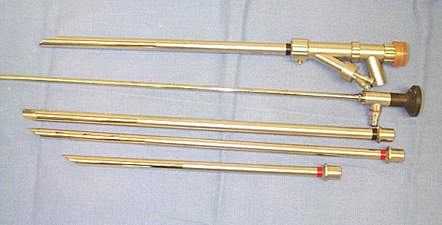

Slide 5
Current Indication for Rigid Bronchoscopy
Diagnostic
  Deep and large quantitative biopsy
  Photographic documentation
  Pediatric bronchoscopy
Therapeutic
  Massive hemoptysis: airway control and assessment
  Tumor ablation / foreign body retrieval
  Laser therapy
  Airway dilatation / “core out” of tumor
  Airway stenting
  Cryotherapy (RB/FB)
  Electrocautery (RB/FB)

Slide 6
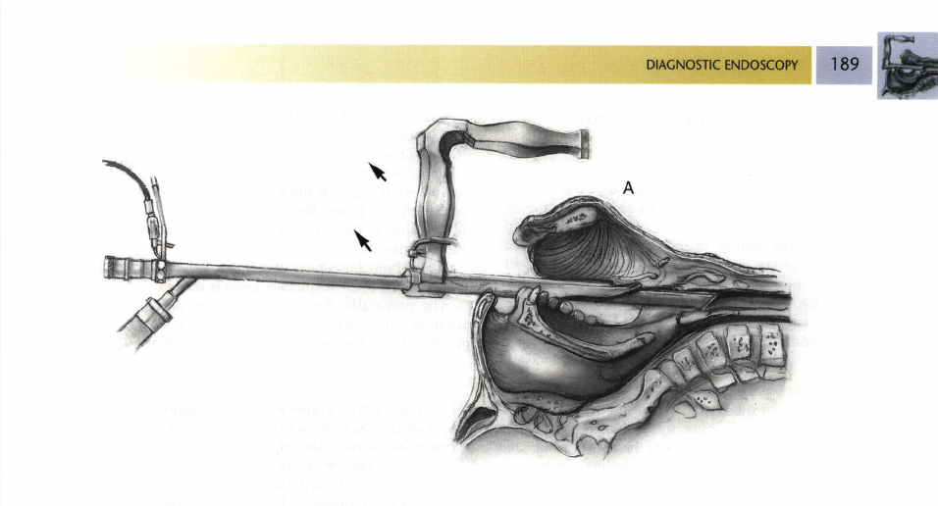

Slide 7
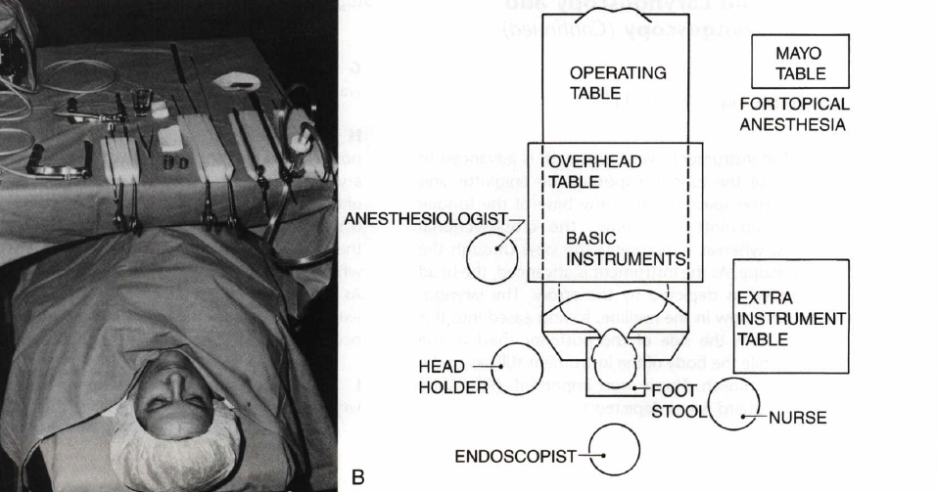

Slide 8
Benefit of RB
  Airway control / ventilation
  Large working channel
  Improved airway visualization
  Large biopsy size
  Absence of coughing and unwanted motion
  Timely multi-modality intervention
Limitation of RB
  Limited availability
  Access to only the more central airways

Slide 9
  Balloon Dilatation
Benign tracheobronchial stenosis of the proximal airways can result from a variety of conditions and can cause dyspnea, cough, wheeze, stridor, or recurrent pulmonary infections.
A variety of modalities may be used to manage benign airway strictures, but none is documented to be uniformly effective .

Slide 10
Balloons used for intravascular procedures can also help to manage endobronchial stenosis secondary to both malignant and benign disease. At our institute,we are currently using the Cordis PTA Dilatation Catheter(Cordis Europa N.V., The Netherlands) for endobronchial narrowings.

Slide 11
The Cordis balloon comes in a variety of diameters and lengths to help dilate areas of bronchial compromise. Occasionally, strictures are dilated prior to the placement of a stent or even used to fully expand a stent already in place.

Slide 12
The balloon is passed endobronchially via either a rigid or flexible bronchoscope. The appropriate diameter andAutofluorescence bronchoscopy / fluorescence bronchoscopy
We use autofluorescence bronchoscopy, also known as blue-light bronchoscopy, to find and diagnose tiny tumors in the lung early on.

Slide 13
During the procedure, we insert a bronchoscope (a thin, lighted tube connected to a camera) through the mouth or nose into the lungs to examine the airways. Under fluorescence, healthy tissues appear green and abnormal tissues appear reddish-brown. Once abnormal tissues are identified, we can remove a small sample of the tissue for further analysis.

Slide 14
This technology allows us to identify areas of abnormality in the bronchial tubes that may not be visible under white-light examination. It also helps us detect cancerous tumors in the earliest stages.
When a tumor is identified early (e.g., while it is still confined to the lung), other procedures may be possible, such as surgery, radiation, laser ablation, photodynamic therapy, and brachytherapy.

Slide 15
length of the balloon are chosen for the particular lesion. Ideally, 5-10 mm of balloon should extend beyond the lesion both proximally and distally.The treatment should be performed as a series of dilatations with gradual increase in the balloon diameter to minimize the risk of tracheobronchial rupture. Once inflated to the prescribed pressure, this dilatation pressure should be maintained for 1-2 minutes. Two minutes is preferable if the patient can tolerate this without discomfort or hypoxia.

Slide 16
Although balloon dilatation is an adjunctive therapy to bronchoscopy, laser, and/or stenting, acquiring skills with this modality is beneficial to the interventionalist and important for the complete endobronchial management of patients with lung cancer.

Slide 17
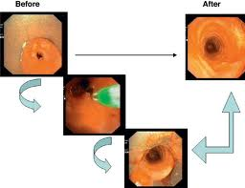

Slide 18
  Stent
    Silicon
    Metallic stent

Slide 19
Silicone or Metal?
Silicone stent
  Require RB
  Easily removed
  Migration
  Can be used in both malignant and benign stenosis
Metal stents
  Easy to insert
  Difficult to remove
  Granulation tissue
  Not recommended for most benign stenosis

Slide 20
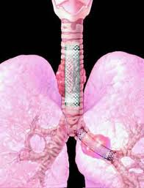

Slide 21
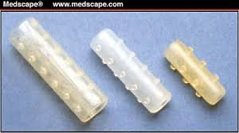

Slide 22
Hot Therapy/ablative
Laser
  CO2 laser
  Nd-YAG laser
    Most powerful
Endobronchial electrocautry
Argon plasma photocoagulation

Slide 23
Nd-YAG laser
Nd: YAG laser
We use the Nd: YAG laser to shrink or destroy tumors and/or to relieve symptoms in difficult-to-reach areas of the body, such as the lungs, esophagus or colon.
The Nd: YAG (neodymium: yttrium-aluminum-garnet) laser uses a high power laser beam that literally burns, or “vaporizes,” the tumor. The cancer is evaporated, and the vapor is then suctioned out through an endoscope or bronchoscope.
The Nd: YAG laser is often used to treat large obstructive masses that can’t be removed surgically, but are causing symptoms, such as bleeding or obstruction. For example, it may be used to remove an obstruction in the esophageal tract to relieve swallowing difficulties, or in the airways to improve breathing.

Slide 24
Nd-YAG laser
Advantages of the Nd: YAG Laser
It allows us to literally vaporize and coagulate a tumor
It can help to reduce the risk of infection at the surgical site
Healing time is often shorter than with traditional surgical procedures
The laser is particularly good for its ability to quickly clot blood
It may be an option for patients who cannot have surgery

Slide 25
Use of airway stent subsequent to endoscopic Nd-YAG laser treatment in central airway obstruction
in a palliative treatment of the central airway severe stenosis, usefulness of the combination management of Nd-YAG laser with following temporary intubation is a better application

Slide 26
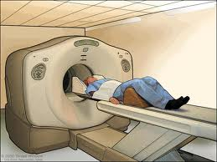

Slide 27
Laser Bronchoscopy
Favorable Lesions
  Polypoid
  Short duration
  Endobroncheal
  Visible distal lumen
  Tracheal, Main bronchus, First segment
  Functional distal lung
Unfavorable Lesions
  External compression
  Total obstruction
  Submucosal infiltration
  Chronic collapse
  Lobar / segmental lesions

Slide 28
Cold Therapy: Cryotherapy
Cryotherapy
Balloon dilatation

Slide 29
Cryotherapy
Endobronchial cryotherapy has been used to destroy endobronchial tumors by its cytotoxic effects of freezing tissue, thus, causing tissue death.

Slide 30
Cryotherapy
Its clinical uses are primarily in treating patients with inoperable obstructive central lung cancers. The mechanism of local tissue destruction is applying extremely low temperatures (below -20 to -40℃).

Slide 31
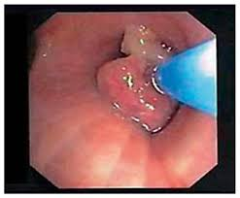
pic

Slide 32
Stent
Silicon stent (by Rigid bronchoscopy)
  Dumon stent
  Y stent
  T tube
SEMT: (RB or FB)
  Ultraflex stent

Slide 33
Selection of Therapy for Airway obstruction
For Urgent Therapy
  Laser, Stent, Rigid Bronchoscopy
For Semi-urgent Therapy
  Cryotherapy, Electrocautery, APC, PDT, Balloon
For Prolonged Therapy
  PDT, Stent, Brachytherapy

Slide 34
Management of COPD
Surgical:
  Bullectomy
  LVRS
  Lung transplantation
Endoscopic:
  Endobronchial Volume Reduction

Slide 35
Bronchoscopic Lung Volume Reduction In Severe Emphysema
Lung volume reduction surgery (LVRS) produces physiological, symptomatic, and survival benefits in selected patients with advanced emphysema.

Slide 36
Bronchoscopic Lung Volume Reduction In Severe Emphysema
Because it is associated with significant morbidity, mortality, and cost, nonsurgical alternatives for achieving volume reduction have been developed. Three bronchoscopic lung volume reduction (BLVR) approaches have shown promise and reached later-stage clinical trials.

Slide 37
Bronchoscopic Lung Volume Reduction In Severe Emphysema
These include the following:
(1) placement of endobronchial one-way valves designed to promote atelectasis by blocking inspiratory flow;
(2) formation of airway bypass tracts using a radiofrequency catheter designed to facilitate emptying of damaged lung regions with long expiratory times; and
(3) instillation of biological adhesives designed to collapse and remodel hyperinflated lung.

Slide 38
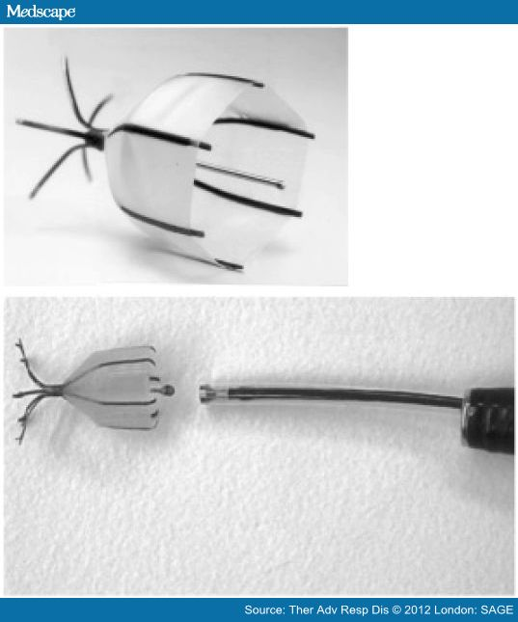
Intrabronchial valve (Spiration Inc.) with delivery system deployed via working channel of bronchoscope.

Slide 39
Why BLVR
Because LVRS:
  High risk patient?
  Invasive procedure
  High morbidity (45-75%)
  Underestimation of mortality (2yr: 27%)
  Cost expensive
  Availability
  Irreversible

Slide 40
Endobroncheal Valve
One way valve blocker at airway → shrinkage of emphysematous segment / lobe (50%) → increasing FEV1 (50%), life quality (most), decreasing O2 dependent (most)
  Emphasys endobroncheal valve (CE)
  Spiration endobroncheal valve (NA)

Slide 41
Bronchoscopic Valve placement
A range of different other techniques such as
endobronchial blockers,
airway bypass,
endobronchial valves,
thermal vapor ablation,
biological sealants,
and
airway implants
have been employed on both homogeneous as well as heterogeneous emphysema.

Slide 42
Bronchoscopic Valve placement
The field of bronchoscopic lung volume
reduction continues to evolve as ongoing
prospective randomized trials build on
earlier feasibility data to clarify the true
efficacy of such techniques.

Slide 43
DIAGNOSTIC BRONCHOSCOPY

Slide 44
Diagnostic Bronchoscopy
TBNA
Autofluorescence Bronchoscopy
Navigational Bronchoscopy

Slide 45
Trans Bronchial Needle Aspiration
Routinely TBNA is done for mediastinal LNs enlargement specially
  Subcarinal and Paratracheal LNs

Slide 46
  Endobroncheal ultrasound guided TBNA is much safer choice.

Slide 47
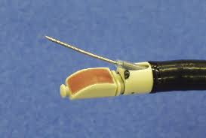

Slide 48
Autofluorescence Bronchoscopy
We use autofluorescence bronchoscopy, also known as blue-light bronchoscopy, to find and diagnose tiny tumors in the lung early on.
During the procedure, we insert a bronchoscope (a thin, lighted tube connected to a camera) through the mouth or nose into the lungs to examine the airways. Under fluorescence, healthy tissues appear green and abnormal tissues appear reddish-brown. Once abnormal tissues are identified, we can remove a small sample of the tissue for further analysis.

Slide 49
Autofluorescence Bronchoscopy
This technology allows us to identify areas of abnormality in the bronchial tubes that may not be visible under white-light examination. It also helps us detect cancerous tumors in the earliest stages.
When a tumor is identified early (e.g., while it is still confined to the lung), other procedures may be possible, such as surgery, radiation, laser ablation, photodynamic therapy, and brachytherapy.

Slide 50
Autofluorescence Bronchoscopy
Lacking Evidence in 2005
  Nature history of early lesions
  Do we alter or improve outcomes by performing AFB
  Who do we offer AFB to?
    Lung cancer screening programs
    Can we define the high risk population better?
  Pathologists can agree on biopsies

Slide 51
Autofluorescence Bronchoscopy
Future
  Manufactures should combine AF with standard WLB system
    Adjunct to WL
  Molecular and gene markers will help the pathologists

Slide 52
Diagnosis of Peripheral Nodules < 2 cm
CT guide TTNA
  Pneumothorax
    20-30%
    3-15% require chest tubes
  CT time slot
  Radiation
Surgery
  Invasive
  Expensive
  Up to 99% of nodules are non-malignant

Slide 53
Navigational Bronchoscopy
CT roadmap
Real-time location of the tumor
Application for NB
  TBNA, TBLB
  Minimal invasive cancer therapy
    RF ablation
    Brachytherapy
    Stereotactic radiosurgery
    PDT?

Slide 54
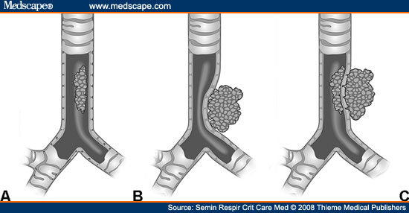

Slide 55
Argon plasma coagulation (APC)
Argon plasma coagulation (APC) is a new method of non-contact electrocoagulation, using high frequency current by means of ionized argon gas (argon plasma). Recently, this technique has become available for flexible endoscopic delivery through special probes.
APC treatment is used for malignant neoplasms of the tracheobronchial system causing obstruction and/or recurrent bleeding.
Immediate airway patency and haemostasis are obtained.

Slide 56
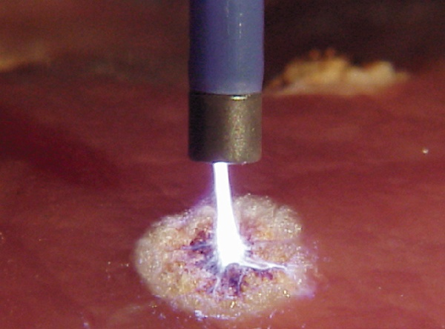

Slide 57
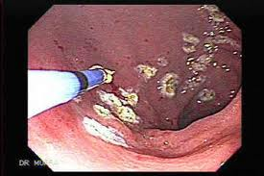

Slide 58
Brachytherapy in lung cancer
Brachytherapy, the direct application of a radioactive isotope into the tumor bed, delivers a high dose to the tumor as compared to the surrounding normal tissue.
In the palliative setting, brachytherapy can provide prompt relief of obstructive symptoms and hemoptysis in the majority of patients.

Slide 59
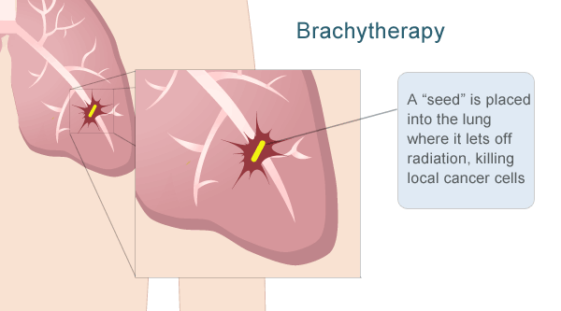

Slide 60
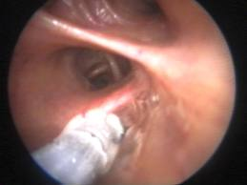

Slide 61
Electromagnetic Navigation Bronchoscopy
Electromagnetic navigation bronchoscopy provides the ability to detect lung cancer and lung disease earlier, even before symptoms are evident, enhancing treatment options for patients .

Slide 62
electromagnetic navigation bronchoscopy
Similar to Global Positioning System technology, electromagnetic navigation bronchoscopy creates a three-dimensional virtual “roadmap” of the lungs from the patient’s CT-Scan that enables a Wellmont physician to steer a unique set of catheters through the lungs to reach the targeted lesion in a minimally invasive manner.

Slide 63
electromagnetic navigation bronchoscopy
Electromagnetic navigation bronchoscopy can be used with a wide-range of patients including those who suffer from poor lung function or have had cancer surgery, chemotherapy, or radiation therapy.

Slide 64
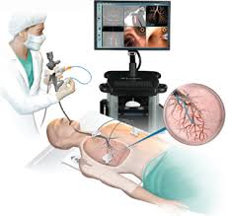

Slide 65
An experienced lung specialist locates one or more lesions deep in the lungs on a CT-Scan. That CT-Scan of the lungs is loaded onto a computer and a virtual three-dimensional “roadmap” of the lungs is generated. The physician marks anatomy points of the lungs and the target lesions on the three-dimensional image to map a route for navigation and steerable catheters to travel through the lungs.

Slide 66
A unique set of catheters is then loaded into the bronchoscope before the procedure begins. These catheters have 360-degree steering capabilities to reach lesions as well as an electromagnetic sensor that allows the physician to track the exact location of the catheters in the lungs.

Slide 67
electromagnetic navigation bronchoscopy
Similar to Global Positioning System technology, electromagnetic navigation bronchoscopy creates a three-dimensional virtual “roadmap” of the lungs from the patient’s CT-Scan that enables a Wellmont physician to steer a unique set of catheters through the lungs to reach the targeted lesion in a minimally invasive manner.

Slide 68
Electromagnetic Navigation Bronchoscopy
Electromagnetic navigation bronchoscopy can be used with a wide-range of patients including those who suffer from poor lung function or have had cancer surgery, chemotherapy, or radiation therapy.

Slide 69
The patient is anesthetized for this outpatient procedure,and the physician passes the bronchoscope containing the unique catheters through the mouth, throat and windpipe, and into the lungs. This allows the electromagnetic sensor to be viewed in real-time on the virtual three-dimensional “roadmap” of the lungs to assist the physician in reaching the target lesions.

Slide 70
Once the target lesions are reached, the steering catheter is removed and tiny surgical instruments are passed through the bronchoscope to collect a biopsy from the lesion for testing and diagnosis.

Slide 71
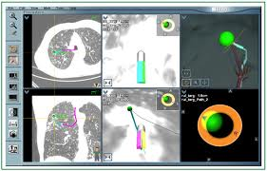

Slide 72
Mediastinoscopy

Slide 73
Patients with isolated mediastinal lymphadenopathy (IML) are a common presentation to physicians, and mediastinoscopy is traditionally considered the "gold standard" investigation when a pathological diagnosis is required. Endobronchial ultrasound-guided transbronchial needle aspiration (EBUS-TBNA) is established as an alternative to mediastinoscopy in patients with lung cancer.
EBUS-TBNA is a safe, highly sensitive, and cost-saving initial investigation in patients with IML

Slide 74
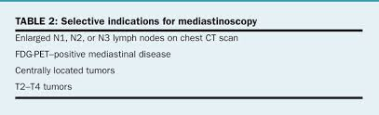

Slide 75
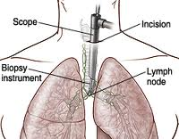

Slide 76
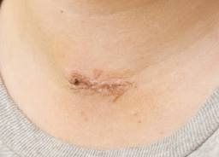

Slide 77
Mediastinoscopy with biopsy
Mediastinoscopy with biopsy is a procedure in which a lighted instrument (mediastinoscope) is inserted in the space in the chest between the lungs (mediastinum), and tissue is taken (biopsy) from any unusual growth or lymph nodes

Slide 78
How the Test is Performed
This procedure is done in the hospital. You will be given general anesthesia so that you are asleep and do not feel any pain. A tube (endotracheal tube) is placed in your nose or mouth to help you breathe.
A small surgical cut is made in the neck. A device called a mediastinoscope is inserted through this cut and gently passed into the mid-part of the chest.

Slide 79
Tissue samples are taken of the lymph nodes around the airways. The scope is then removed and the surgical cut is closed with stitches.
A chest x-ray is usually taken at the end of the procedure.
The procedure usually takes 60 - 90 minutes.

Slide 80
Why the Test is Performed
This procedure is done to look at and then biopsy lymph nodes or any other abnormal growths in the front part of the mediastinum, near your chest wall.
The most common reason is to see if lung cancer (or another cancer) has spread to these lymph nodes. This is called staging.
This procedure is also done for certain infections (tuberculosis, sarcoidosis) and autoimmune disorders.

Slide 81
What Abnormal Results Mean
Abnormal findings may indicate:
Hodgkin's disease
Lung cancer
Lymphoma
Sarcoidosis
The spread of disease from one body part to another
Tuberculosis

Slide 82
The Future of a Pulmonologist

Slide 83


Slide 84


