Slide 1
Acute
Pulmonary Embolism
Dr Sariu Ali Didi
Medical Officer, IGMH
Supervisor Dr Ahmed Migdhaadh Consultant in Internal medicine

Slide 2
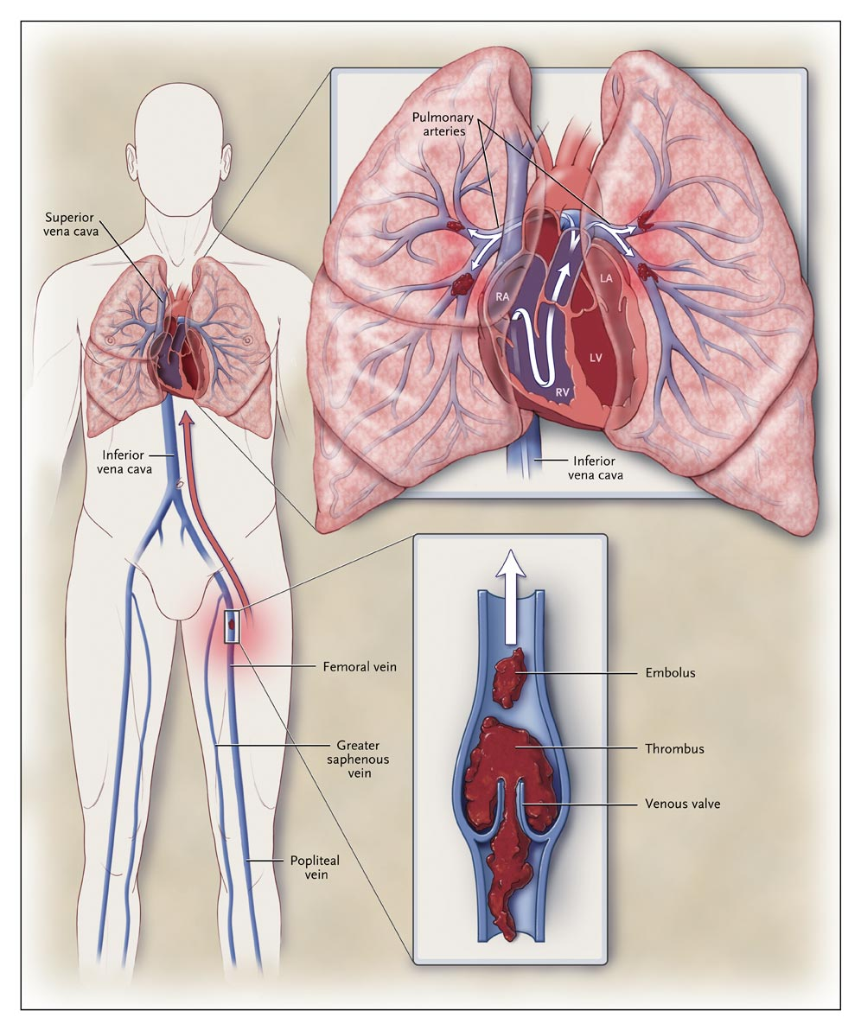
Venous thromboembolism
    DVT
    Pulmonary Embolism
DVT : Blood clot formation with in the large veins usually in the legs
PE results from DVTs that have broken off and travelled to pulmonary arterial circulation
50 % with pelvic vein or proximal leg DVT develop PE
Other causes : Air, Amniotic Fluid, Fat Embolism

Slide 3
Why is it important?
    PE is the most common preventable cause of death in hospitalized patients
    Untreated mortality - 30%
    80% of pulmonary emboli occur without prior warning signs or symptoms
    Diagnosis can be difficult
    Early treatment is highly effective

Slide 4
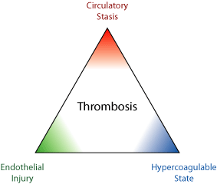
Risk factors
Stasis
Immobility/cast/travel
Advanced age
Acute medical illness
Major surgery
Spinal cord injury
Obesity
Hypercoagulability
Hereditary Deficiencies:
  Antithrombin deficiency
  Protein C deficiency
  Protein S deficiency
  Factor V Leiden
  Prothrombin gene
  mutation
  Dysfibrinogenemia
Acquired:
  Cancer
  Pregnancy & postpartum period
  Oral contraceptives
  Hormone replacement therapy
  Polycythemia rubravera
  Smoking
  Anti phospholipid syndrome
  Chemotherapy
Endothelial Damage
Major surgery
Trauma
Central venous catheterization
Risk for thromboembolism approximately doubles for each decade beyond age 60 years

Slide 5
Risk factors
Major Risk (RR 5-20)
Major and abdominal surgery
Lower Limb Orthopedic Surgery
Obstetric – Late preganancy, LSCS, Pre eclampsia
Maliganancy- Pelvic , abdominal or metastatic
Lower Leg # , varicose veins
History of proven VTE
Minor Risk Factors ( RR
CVS : HF, HTN, Congenital Heart Disease, Central lines
Estrogen : OCP, HRT
Others : Occult malignancy, COPD
Neurological disability, obesity, thrombotic mayeloproliferative disease, nephrotic syndrome
Inflammatory bowel disease

Slide 6
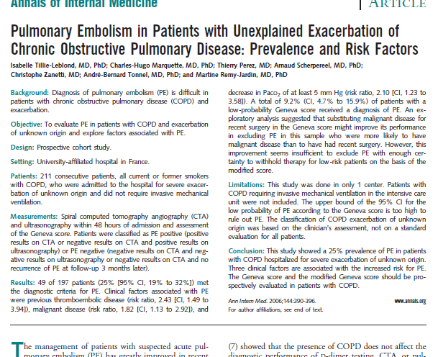

Slide 7
Economy Class Syndrome ??
2001 study : 135.29 million passengers
4.8 case / million > 10,000 Km
1.5case /million - 5ooo – 10,000km
0.01 /million < 5000km
Watching TV equal time pose less risk ; Air Quality might have an effect
Risk increases by ~18% for each 2 hrs increment in a trip

Slide 8
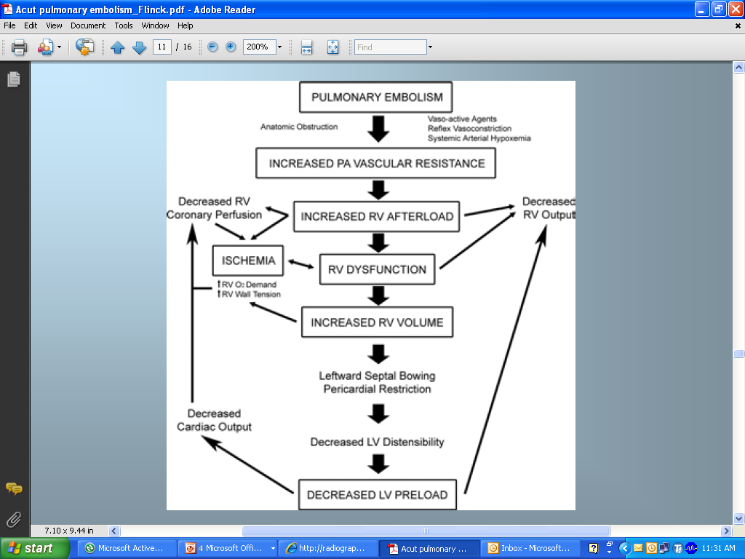

Slide 9
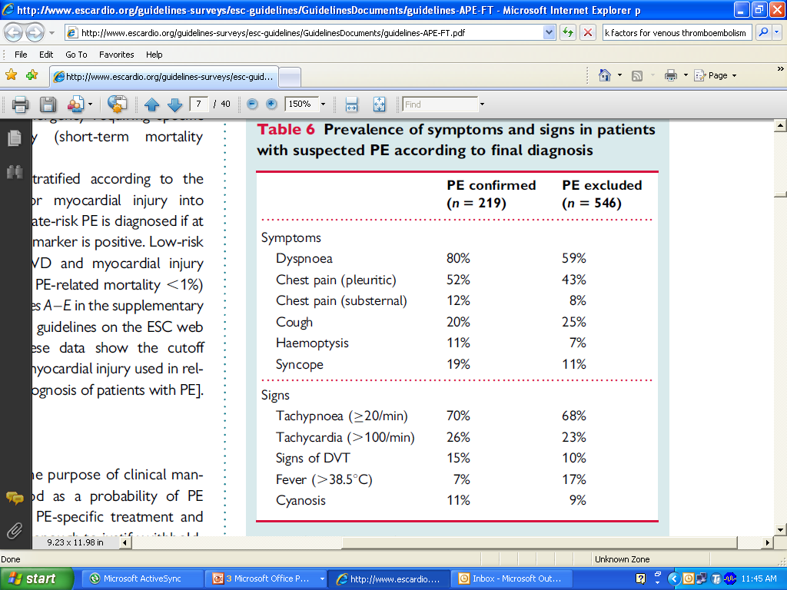
Diagnosis
Clinical Assessment
Non-Specific!!

Slide 10
Diagnosis-Probability Assessment
Validated prediction rules standardize clinical judgement
    Wells
    Geneva
Assessment of PE pretest probability (low, intermediate, or high) and hemodynamic status is essential to guide additional cost-effective evaluation and may aid in the interpretation of subsequent tests.

Slide 11
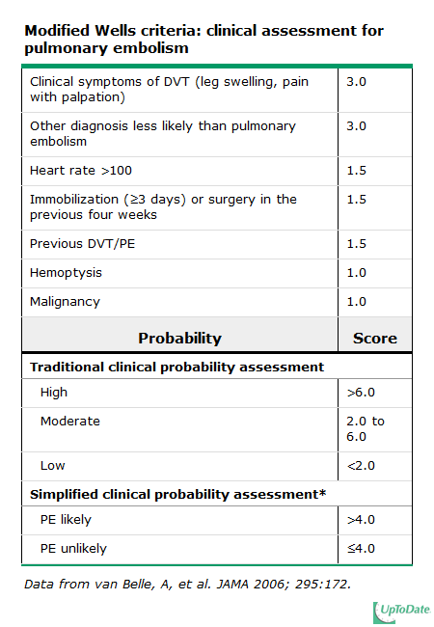
Proportion with PE
65%
30
10%

Slide 12


Slide 13
Biomarker Assays
D-Dimer
  Fibrin degradation product
  ELISA tests are highly sensitive (>95%)
  Non specific (~40%): cancer, sepsis, inflammation increase d-dimer levels
Negative D dimer with Low clinical Probability is sufficient to exclude PE : 92% sensitive
Raised D- dimer does not imply VTE ( negative predictive value )
D dimer should not be done if clinical probability is high

Slide 14
Chest X-Ray
Usually abnormal, but non-specific most useful for excluding other conditions.
Study of 2,322 patients with PE:
  Cardiac enlargement (27%)
  Normal (24%)
  Pleural effusion (23%)
  Elevated hemidiaphragm (20%)
  Pulmonary artery enlargement (19%)
  Atelectasis (18%)
  Parenchymal pulmonary infiltrates (17%)
Westermark sign ?
Hampton hump ?
  Chest Radiographs in Acute Pulmonary Embolism: Results From the International Cooperative Pulmonary Embolism Registry. Chest July 2000 118:3338; 10.1378/chest.118.1.33

Slide 15
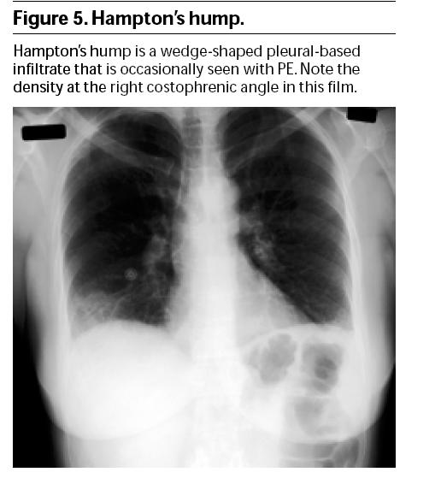
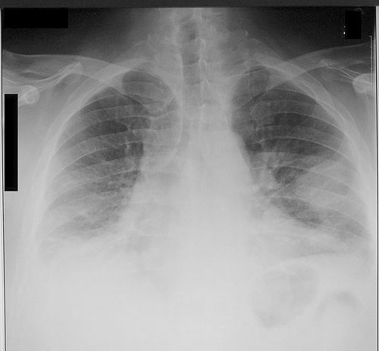
Hampton hump : a peripheral conical density with the base apposed to the chest wall
more specific but are not commonly seen

Slide 17
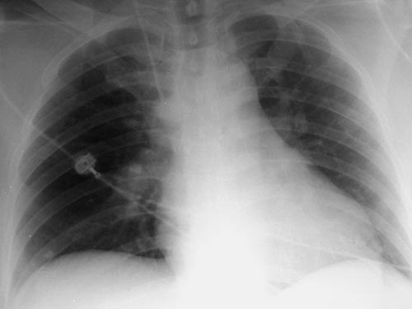
The Westermark sign : focal oligemia distal to a PE

Slide 18
ECG
Sinus Tachycardia – Most common
RV strain patterns suggest severe PE
  Inverted T waves V1-V4
  QR in V1
  Incomplete RBBB
  S1Q3T3

Slide 19
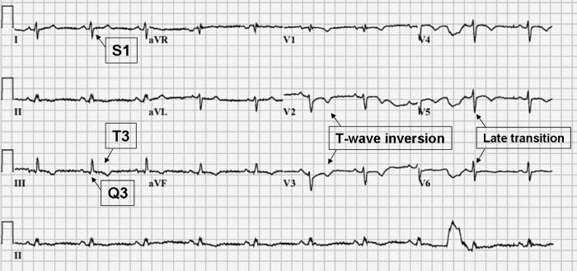
S1Q3T3 and T wave changes

Slide 20
CT angiography (CTA), using a multidetector spiral scanning system
primary diagnostic method for suspected PE
the sensitivity and specificity for detection PE > 90%
provide clues to possible alternative diagnoses in patients with symptom consistent with PE
BUT…
Dye load and large radiation dose

Slide 21
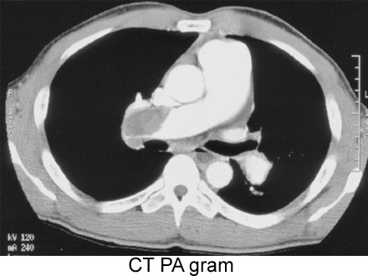

Slide 22
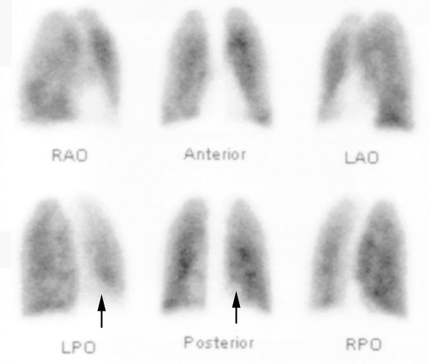
V /Q Scan
V /Q lung scanning remains an option and can be used when CTA is not available or is contraindicated.
Advantages
relatively low radiation dose
no requirement for contrast dye
Limitations
Unreliable in pts with COPD and other conditions in which there is structural Lung disease
When holding breath is difficult.

Slide 23
V /Q scanning is most useful in patients with normal cardiopulmonary status prior-to the acute illness
Interpretation of V/Q scanning is highly dependent 0n the pretest likelihood of the presence of PE.
The sensitivity may range from 50% to 98% and specificity from 20% to 60%.
The highest specificity is attained with multiple Large (lobar or segmental) perfusion defects without anatomically matching ventilation abnormalities.
Normal results effectively exclude PE; multiple, large, mismatched results in the setting of high pretest probability confirm PE.

Slide 24
compression ultrasonography of the legs
useful in situation in which dye or radiation exposure is undesirable (for example, dye allergy or pregnancy, respectively)
lf DVT is identified : Therapy should be initiated for DVT and the presumed PE because treatment for both conditions is similar
If no DVT is identified - chest imaging will be needed
If diagnosis of PE is initially made with chest imaging (CT or V /Q scanning) - lower extremity USG is not necessary.

Slide 25
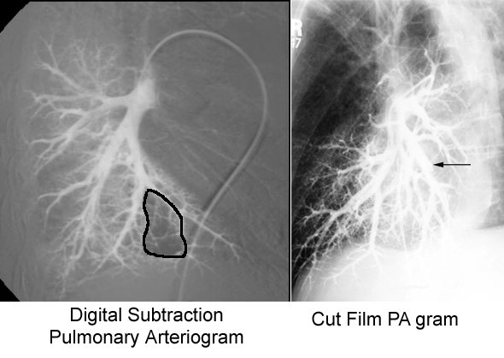
Pulmonary Angiography
Used less often
Confirmation or indeterminate cases
Invasive

Slide 26
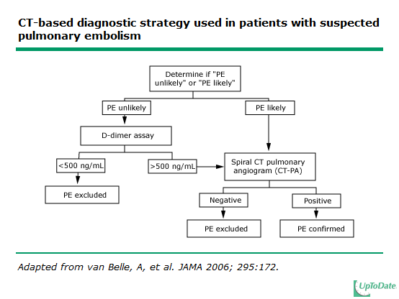

Slide 27
Risk Stratification
PE can be stratified into several levels of risk of early death risk markers.
Immediate bedside clinical assessment for the presence or absence of clinical markers allows stratification into high-risk and non-high-risk PE

Slide 28
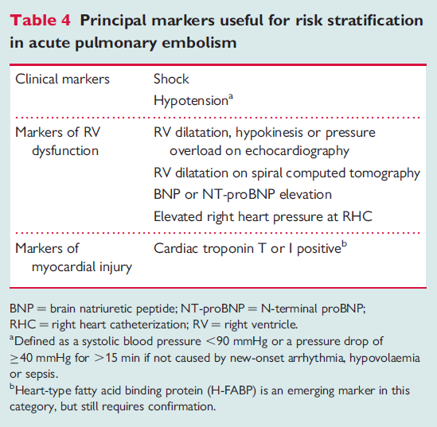

Slide 29
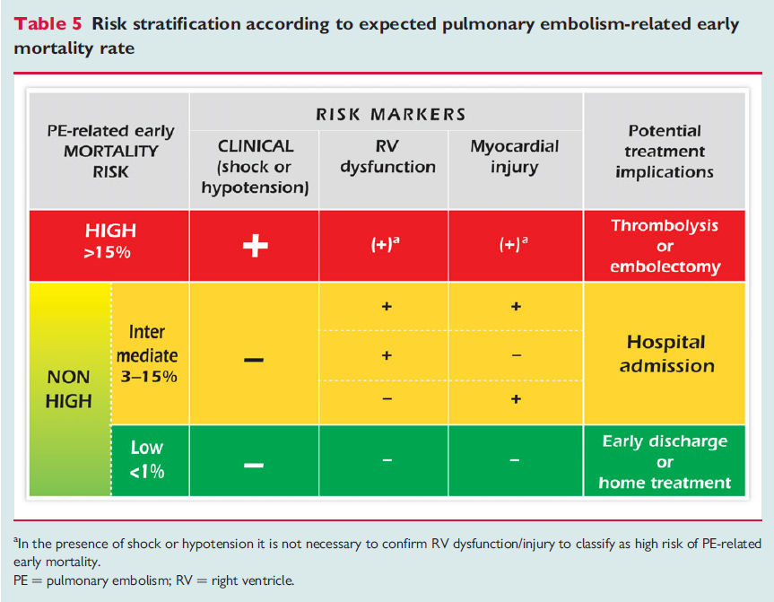

Slide 30
Acute Treatment
The initial focus of PE treatment is stabilization with assessment of hemodynamic stability and hypotension.
Hemodynamically Stable Patient
Anticoagulation: Initiate anticoagulation immediately and achieve therapeutic levels of anticoagulation within 24 hours; failure to do so correlates with an increased risk of clinical progression and recurrence.

Slide 31
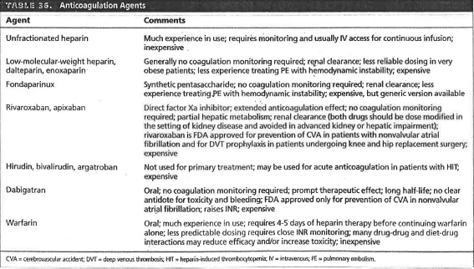

Slide 32
Warfarin is generally begun at the time one of the IV/S/C anticoagulants is started
Overlapping therapy with warfarin and one of the IV or s/c agents should be continued until a therapeutic INR is documented for 2 or more consecutive days

Slide 33
Outpatient VS Inpatient Mx
Hemodynamically stable patients with
normal biomarkers/cardiac ultrasound,
no significant comorbidities (such as cancer, heart failure,COPD) or need for supplemental oxygen
younger age( <75-80 years)
low risk of anticoagulation complications
ability to adhere to prescribed treatment

Slide 34
Hemodynamically Unstable Patient
Hemodynamic instability reflects substantial elevation in pulmonary vascular resistance and pulmonary artery pressure, which compromises right ventricular function and cardiac output via decreased left ventricular filling, with consequent decrease in systemic blood pressure.
Hemodynamically unstable patients usually require supplemental oxygen and may require mechanical ventilation.
Fluid resuscitation may improve right ventricular function; however, rapid fluid infusion may exacerbate pulmonary hypertension and compromise right ventricular function.
In the setting of otherwise refractory hypotension, vasoconstrictor should be administered to raise systemic arterial pressure, a key determinant of coronary blood flow.

Slide 35
Because of their higher risk for complications and mortality, patients with refractory hypotension due to pulmonary embolism should be treated with thrombolytic therapy, followed by anticoagulation.

Slide 36
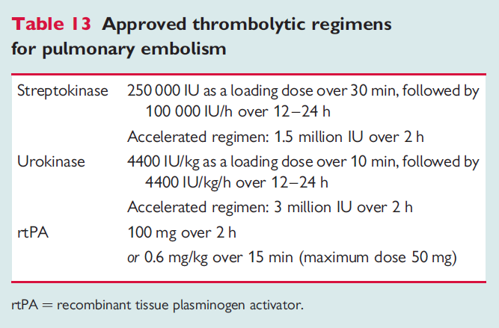

Slide 37
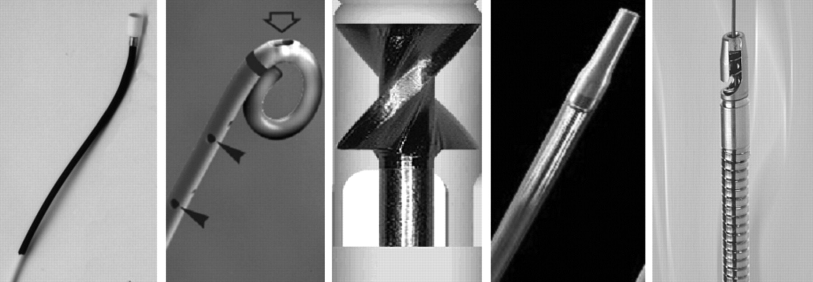
Catheter Embolectomy & Fragmentation
An alternative in high-risk PE patients when thrombolysis is absolutely contraindicated or has failed
Kucher N Chest 2007;132:657-663

Slide 38
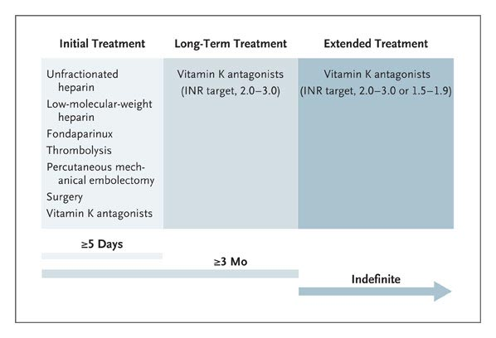
Treatment of Acute Pulmonary Embolism
First unprovoked PE:
rx for at least 3-6 months
Recurrent PE
or PE and uncured cancer:
Consider long term anticoagulation if benefits>risk
Agnelli G, Becattini C. N Engl J Med 2010;363:266-274

Slide 39
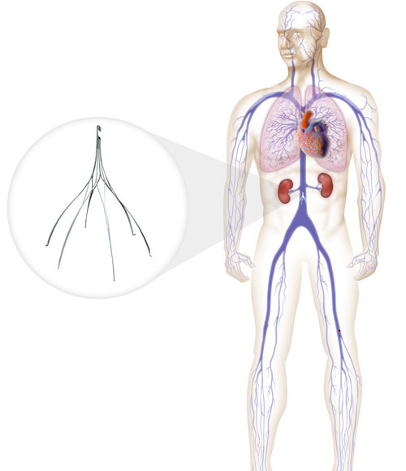
IVC Filters
May provide lifelong protection against PE
Unclear effect on overall survival
Complications:
  DVT (20%)
  Post thrombotic syndrome (40%)
  IVC thrombosis (30%)
Consider in pregnant women with extensive thrombosis
Optimal duration of retrievable filters is unclear

Slide 40
Poor Prognostic Signs
Hypotension (not caused by arrhythmia, sepsis, or hypovolemia)
  SBP <90 mm Hg = 53% 90-day all cause mortality
  SBP drop of 40 mm Hg for at least 15 minutes = 15% in–hospital mortality
Syncope= bad
Shock= really bad

Slide 41
Poor Prognosis: myocardial injury
Troponin levels correlate with in-hospital mortality and clinical course in PE
Troponins do not necessarily mean “MI”
Significantly increased mortality in patients with troponin level >0.1 ng/ml (O.R.= 6)
Normal troponin has very high NPV (99-100%)
Prognostic value of troponins in acute pulmonary embolism: a meta analysis. Circulation 2007;116:427-433

Slide 42
Poor Prognosis: myocardial dysfunction
Brain natriuretic peptide
  Elevated levels related to worse outcomes.
  Low levels can identify patients with a good prognosis (NPV 94-100%)
  Prognostic role of brain natriuretic peptide in acute pulmonary embolism. Circulation 2003;107:2545-2547

Slide 43
CT evidence of RV dysfunction
RV dilation
RV/LV short axis >1= pulmonary hypertension
RV/LV short axis >1.5= severe PE
Leftward septal bowing

Slide 44
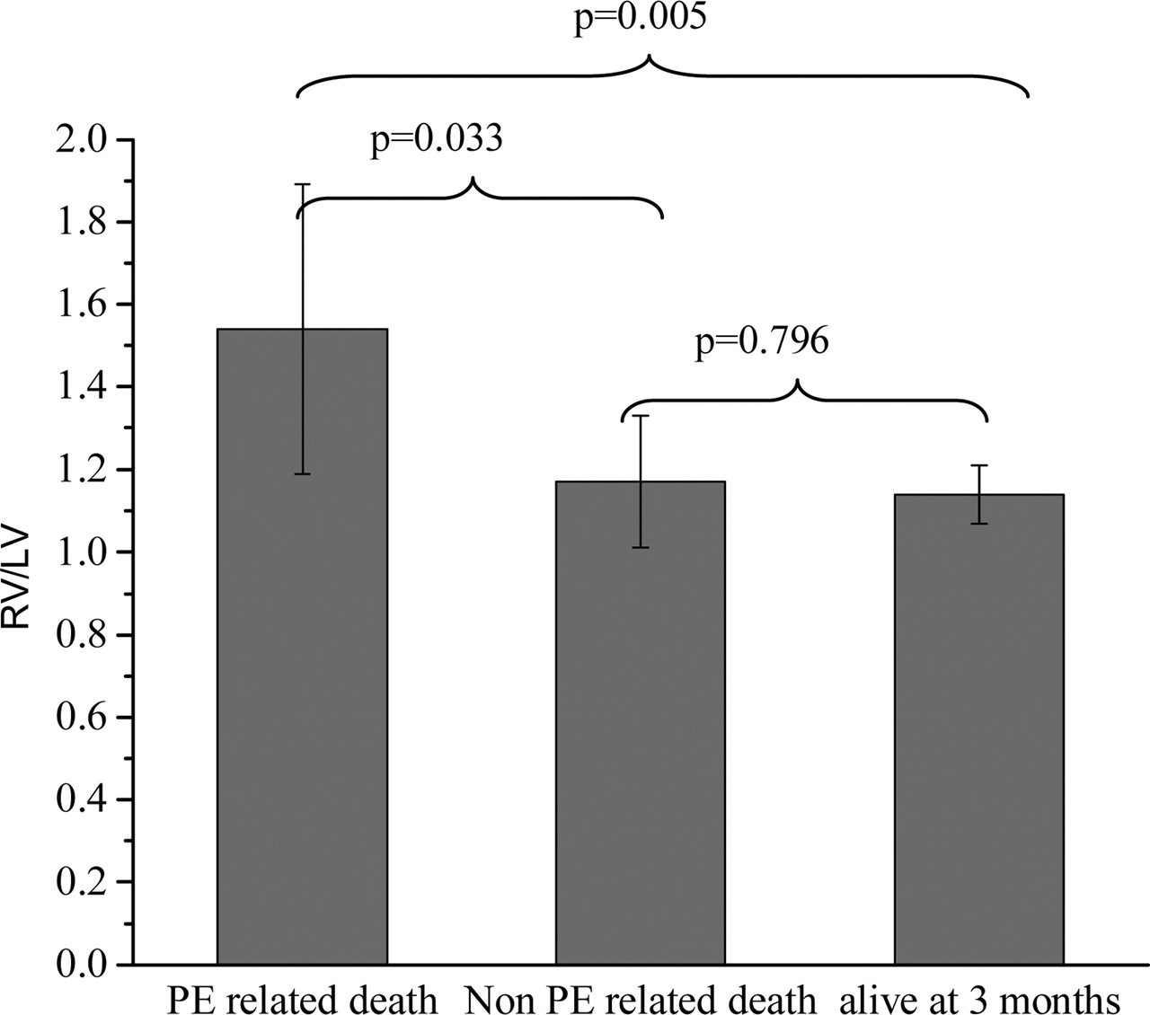
Graph of mean values of the RV/LV ratio relative to clinical outcome.
van der Meer R W et al. Radiology 2005;235:798-803
©2005 by Radiological Society of North America
Notes:
Figure 2. Graph of mean values of the RV/LV ratio relative to clinical outcome. Bars represent means and lines represent 95% confidence intervals. The mean RV/LV ratio was significantly higher in patients who died of PE than in the other patients (analysis of variance, P = .018). Brackets show significant differences between groups.

Slide 45
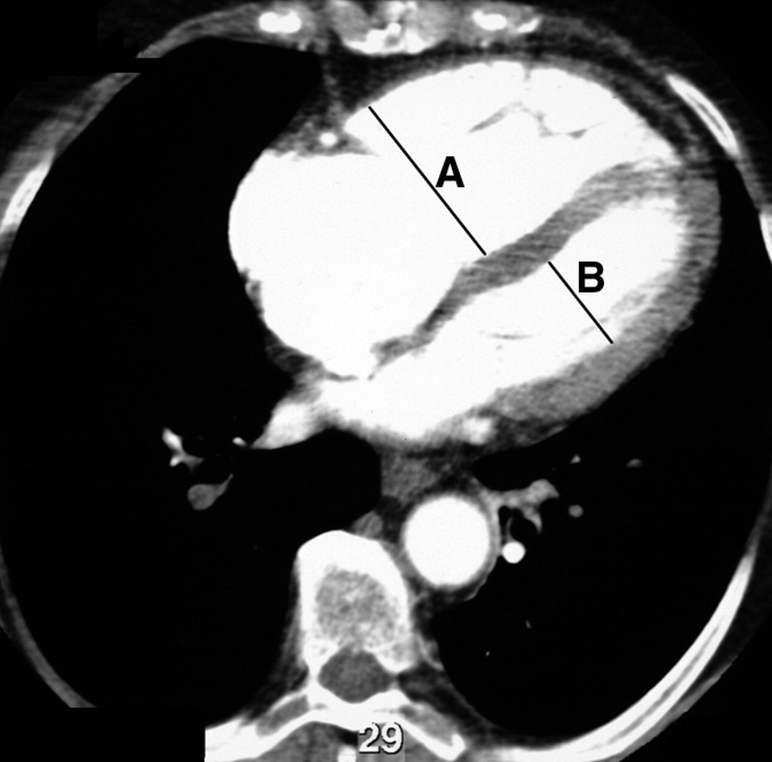
Transverse contrast-enhanced CT scan shows maximum minor axis measurements of the right ventricle (A) and left ventricle (B).
van der Meer R W et al. Radiology 2005;235:798-803
©2005 by Radiological Society of North America
Notes:
Figure 1. Transverse contrast-enhanced CT scan shows maximum minor axis measurements of the right ventricle (A) and left ventricle (B). Note the flattening of the interventricular septum. RV/LV ratio = 1.81.

Slide 46
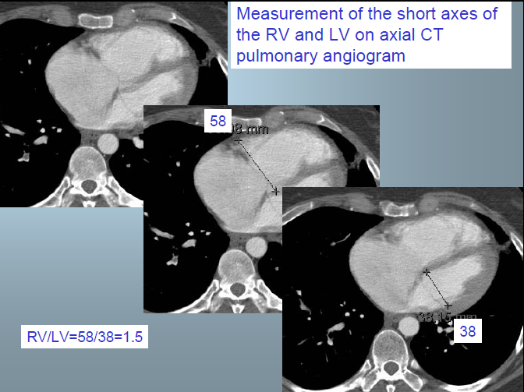

Slide 47
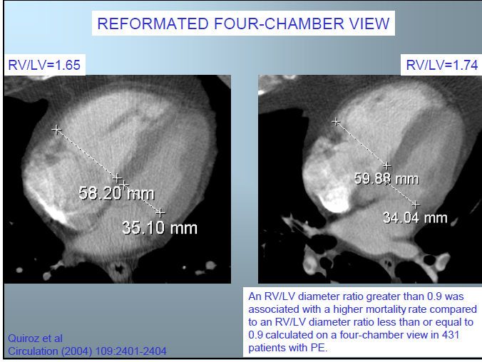

Slide 48
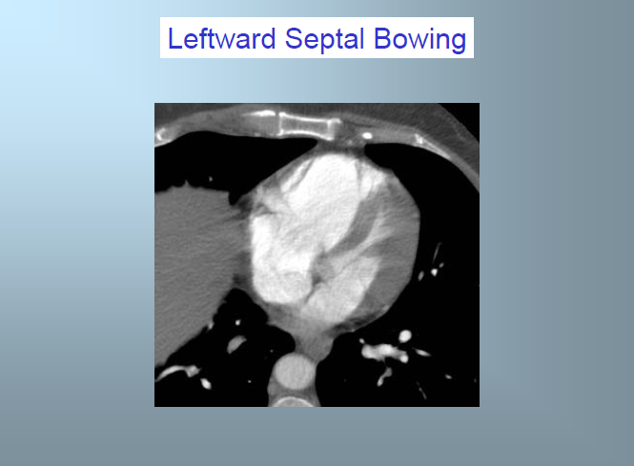

Slide 49
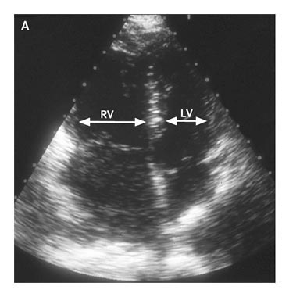
Echocardiograms before and after Thrombolysis
Echocardiography-RV Dilation
Notes:
Echocardiograms before and after Thrombolysis. A 29-year-old woman presented with progressive shortness of breath. A computed tomographic scan of the chest showed a central "saddle" pulmonary embolism. An echocardiogram (Panel A) showed an enlarged right ventricle and hypokinetic motion of the right ventricular free wall. After treatment with alteplase, the right ventricular size and wall motion returned to normal (Panel B). Echocardiograms courtesy of Scott D. Solomon, M.D., and Jose M. Rivero. (Videos of these images are available with the full text of this article at http://www.nejm.org.)‏

Slide 50
The key is prevention
DVT prophylaxis in at-risk patients is quite effective

Slide 51
Questions???

