Slide 1
Deep Vein Thrombosis (DVT) & PULMONARY EMBOLISM (PE)

Slide 2
Dr. (Mrs.)Minnu M. Panditrao
CONSULTANT
DEPARTMENT OF ANESTHESILOLOGY AND INTENSIVE CARE
PUBLIC HOSPITAL AUTHORITY’S
RAND MEMORIAL HOSPITAL FREEPORT
GRAND BAHAMA
COMMONWEALTH OF THE BAHAMAS

Slide 3
Formerly:
Professor
Department of Anaesthesiology
& Critical Care
Dr. D Y Patil Medical College
Pimpri, Pune

Slide 4
Case - 1
Mr. Patil- 71 y/o man admitted to general medicine ward service.
HPI: gradually increased S.O.B. over 8 days assoc. with new productive cough, rhinorrhea and fatigue.
PMH: COPD, CHF (LVEF 35%), RFTs(S. creatinine 2.5)
Clinically: obvious Resp. Distress with SPO₂ 93% on RA
Barrel chested, b/l expiratory wheezes, prolonged expiratory phase,
CXR: hyperexpanded, no infiltrate, consolidation or edema.
DX: COPD Exacerbation

Slide 5
Case - 2
Mr. More- 62 y/o man admitted to general Surgical ward service.
HPI: Swelling in rt. Inguinal region over 3 Years, now assoc. with irreducibilty, pain and distention of abdomen.
PMH: COPD, hypertension and Ch. Smoker
Clinically : No obvious respiratory distress
Barrel chested, b/l expiratory wheezes,
CXR: hyperexpanded, no infiltrate, consolidation or edema.
DX: rt. indirect Inguinal Hernia, COPD and Hypertension

Slide 6
Case - 3
Mrs. Vadhwani- 56 y/o, 82 kg. woman admitted to Gynaecology ward service.
HPI: A case of Post-menopausal Bleeding, operated for TAH, under Spinal Analgesia 2 days back, now having mild pain & swelling in lt. leg
PMH:, hypertension, DM and ECG changes
Clinically : No obvious respiratory distress
Extremely obese, short neck, BP 150/ 96 mm Hg.
CXR: no infiltrate, consolidation or edema.
DX: Post –op. Pt. Obese, with DM, Hypertension

Slide 7
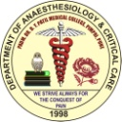
Are these Potential DVT/ PE Patients?
Are these patients at risk for Venous Thrombo Embolism (VTE)?
Why worry about VTE in inpatients?
What is the prevalence of DVT/PE in hospitalized medical and surgical patients?
What are effective methods of prophylaxis?

Slide 8
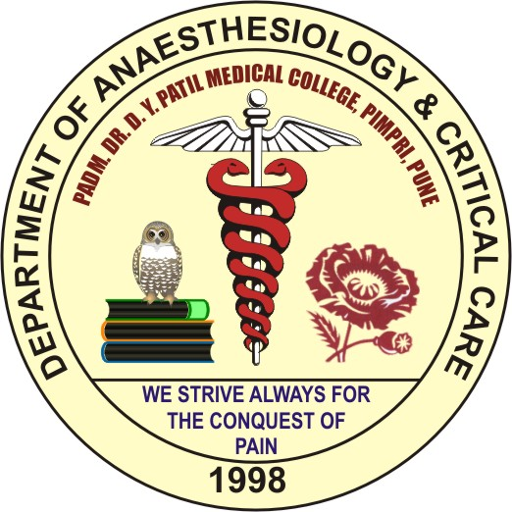
DEEP VEIN THROMBOSIS (DVT)
Enigmatic
Dilemmatic
Mysterious
Dreadful
Potentially Dangerous
Usually fatal

Slide 10
Incidence
What % of all hospital related deaths due to fatal PE, secondary to DVT?
7-10%
What % of these pts had NO pre-morbid symptoms?
70-90%
200,000 potentially preventable annual deaths due to PE secondary to DVT in the US
Sandler DA JR Soc Med 1989; 82, Lindblad B Br Med J 1991; 302.

Slide 11
Prevalence
3 out of 4 hospital pts dying from PE have NOT had recent surgery…
2.5% of medical patients immobilized with multiple clinical problems suffer fatal PE.
National DVT Free Registry
60% of patients dx with acute DVT were in the peri-hospitalization period
60% of cases were in non-surgical patients!
Haas, S. Seminars in Thrombosis and Haemostasis, 2002; Goldhaber, SZ Am J Cardiol 2004.

Slide 12
Prevalence in Medical Pts
3 large-scale randomized studies (5500 medically ill patients)
DVT identified w/ screening studies
Patients receiving no prophylaxis:
VTE 11-15% of patients
Proximal DVT- 4-5% of patients
Rates similar to moderate-high risk general surgery patients.
Samana, MM NEJM, 1999; Leizorovicz, A Circulation 2004; Cohen, AT J Thromb Haemost, 2003.

Slide 13
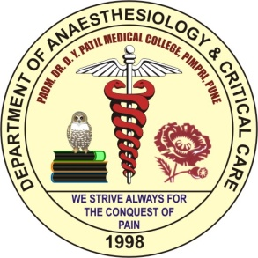
Venous Thromboembolism (VTE)
A venous thromboembolism (VTE) is a formation, development, or existence of a blood clot or thrombus within the venous system.

Slide 14
Venous thromboembolism (VTE) includes
Deep vein thrombosis (DVT) and
Pulmonary embolism (PE)
VTE is one of the most common complications of the hospitalized patients
PE is the most common preventable cause of hospital deaths

Slide 15
ICU Venous Thromboembolism Overview
Secondary
Development
Primary Presentation
Hemodynamic Instability
Respiratory Failure
Virchows Triad
Diagnostics
Hypercoaguable (25%)
Stasis
Vessel Damage
Cardiac Echo Spiral CT
Doppler US D-dimer
Angiogram
Therapeutics
UF Heparin
Thrombolytics
Warfarin
Argatroban
LMWH
Lepirudin

Slide 16
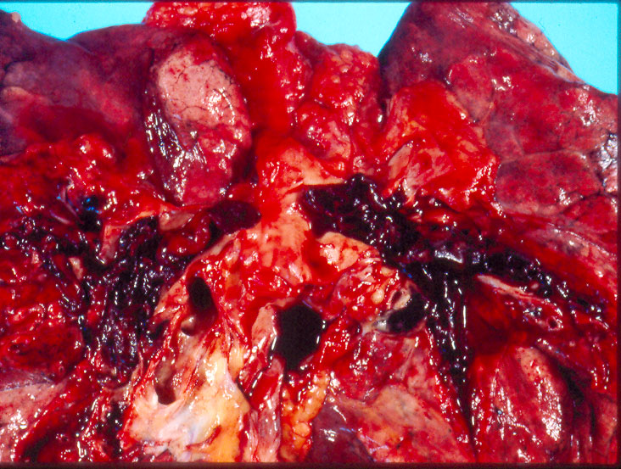
Venous Thromboembolism
Pathophysiology of Thrombosis

Slide 17
Venous Thromboembolism
“ The detachment of larger or smaller fragments from the end of the softening thrombus are carried along by the current of blood and driven in remote vessels. This gives rise to the very frequent process upon which I have bestowed the name EMBOLIA.”
Virchow 1846
Vessel Injury
Stasis
Hyper-coagulability
Acquired
Inherited

Slide 18
Virchows Triad
Hypercoagulable
Stasis
Vessel Damage

Slide 19
Intensivists General Paradigm
Pipes
Stuff
Flow

Slide 20
Clot Bleed
Stuff
Pipe
= Biologically Active Conduit
Stuff
Flow
Coagulation fibrinolysis

Slide 21
Bleed
Clot
Stuff
Pipe
= Biologically Active Conduit
Stuff
Flow (stasis)
Coagulation fibrinolysis

Slide 22
Pathogenesis of Venous Thromboembolism Thrombogenic Stimuli
Endothelial Damage
Exposure of tissue factor/subendothelial matrix
Hypoxia → receptors for leukocytes
Activation by inflammatory cytokines (IL-1, TNF)
Express tissue factor
Internalize thrombomodulin
Release PAI-1
Activation of Coagulation
Inflammation (IL-1, TNF)
Monocytes → tissue factor and tethered leukocytes
Internalize thrombomodulin (↓ Protein C activation)
Shedding endothelial protein C receptor
Coagulation cascade activation
Bleed
Clot
Adapted from Wertz Lung Biology Health Disease 2003

Slide 23
Pathogenesis of Venous Thromboembolism Thrombogenic Stimuli
Bleed
Blood Flow (Stasis)
Systemic
Immobilization pools blood in calf venous sinuses
Increased blood viscosity
Local
Hypoxia of valve cusps produces tissue factor and activates coagulation
Accumulation of clotting factors in venous sinuses of calf or valve cusp pockets
Clot
Adapted from Wertz Lung Biology Health Disease 2003

Slide 25
Risk Factors for VTE
Surgery
Trauma (major or lower extremity)
Immobility, paresis
Malignancy
Cancer therapy
Previous DVT
Increasing age
Pregnancy and the postpartum period
Estrogen-containing oral contraceptives or hormone replacement therapy
Selective estrogen receptor modulators
Acute medical illness
Heart or respiratory failure
Inflammatory bowel disease
Nephrotic syndrome
Myeloproliferative disorders
Parxysmal nocturnal hemoglobinuria
Obesity
Smoking
Varicose veins
Central venous catheterization
Inherited or acquired thrombophilia

Slide 26
Calculation of clinical pretest probability (Wells DVT Score)
Active cancer (on treatment for last 6 months or palliative) 1
Paralysis, paresis or plaster immobilization of lower limb 1
Immobilization previous 4 days 1 Entire leg swollen 1
Calf Swollen by more than 3 cm 1
Pitting edema 1
Collateral superficial veins (non-varicose) 1
Probable alternative diagnosis -2
(If both legs are symptomatic, score the more severe leg)

Slide 27
Interpretation of the score
≥ 3 High DVT Risk
1-2 Moderate DVT Risk
<1 Low DVT Risk

Slide 28
Calculation of Clinical Probability of PE
(Modified Wells PE Score)
Clinical Signs 3
Alternative Diagnosis unlikely 3
Hear rate >100 1.5
Immobilization previous 4 days 1.5
Previous DVT/PE 1.5
Hemoptysis 1
Malignancy (treatment in last 6 months) 1
Interpretation of the score
≤ 4 PE less likely > 4 PE likely

Slide 29
Risk of DVT in Surgical Patients

Slide 32
Absolute Risk Prevalence
Patient Group
Medical patients
General surgery
Major gynecologic surgery
Major urologic surgery
Neurosurgery
Stroke
Hip or knee arthroplasty, hip fracture surgery
Major trauma
Spinal cord injury
Critical care patients
DVT Prevalence, %
10 – 20
15 – 40
15 – 40
15 – 40
15 – 40
20 – 50
40 – 60
40 – 80
60 – 80
10 – 80

Slide 33
ICU Venous Thromboembolism
ICU Risk Factors | Hypercoag | Stasis | Vessel
Major Surgery | X | X | X
Trauma | X | X | X
MI/CHF |  | X
Stroke |  | X
Burns |  | X
Sepsis | X | X
Catheter | X | X | X
Adopted from Dalen CHEST 2002; 122:1440-56

Slide 34
DIAGNOSIS OF DVT/ PE

Slide 35
Algorithm for Diagnosis of DVT
Clinical suspicion of DVT
Determine probability
Low
Moderate/high
D-dimer test
+ ive
Duplex ultra sound (with compression)
- ive
Out of guidline
- ive
+ ive
DVT confirmed Treatment
- ive
D-dimer test Moderate/high
probability
+ ive
Follow-up studies / repeat duplex ultrasound (3-7 days) or venography

Slide 36
Algorithm for Diagnosis of Pulmonary Embolism
Clinical sign & symptoms of PE
Wells Score
Start heparin if >6, Perform D-dimer test
PE less likely
PE likely
D-dimer
Perform CTPA
R/w clinical probability & D dimer results
Diagnosis of PE
VTE Treatment algorithm
PE less likely & ‘+’ D dimer results
PE likely & ‘-’ D dimer results
PE likely with ‘+’ D dimer results
Risk of PE is low. Consider other diagnosis
Perform duplex ultrasound of the leg
Ultrasound results?

Slide 37
Venous Thromboembolism Treatment Algorithm
Diagnosis of DVT/PE
No
Complicated thromboembolism of comorbidities?
LMWH , UFH/ Fondaparinex
Warfarin
Outpatient protocol
OP treatment appropriate?
Patient education
Inpatient treatment
Other Therapies
Complication during therapies
Anticoagulation Failure?
Cnt. Anticoagulation with followup & secondary prevention

Slide 38
Prophylaxis of DVT

Slide 39
Importance of DVT Prophylaxis
DVT
Recurrence
Acute DVT/PE
Valvular Damage
Symptomatic proximal DVT can be an extension of distal DVT that was previously asymptomatic
Significant number of fatal PE’s NOT preceded by symptomatic DVT
Most preventable cause of hospital associated death in medical or surgical patients → PE
PE
Post-phlebitic syndrome

Slide 40
Natural History of DVT
132 Surgical patients no prophylaxis
70%
No DVT (92)
30%
DVT (40)
35% Calf with spontaneous lysis (14)
42% Calf only (17)
23% propagation Popliteal/femoral (9)
56%
No PE (5)
44%
PE (4)
Kakkar Lancet 1969; 6:230-32

Slide 41
VTE Prophylaxis
Pharmacologic
Unfractionated heparin
Low molecular weight heparin
Vit K Antagonists
Mechanical
IVC filters
Intermittent Pneumatic Compression Devices
Graduated
Compression
stockings

Slide 49
VTE Prophylaxis: Recommendations
Surgery | Recommended Prophylaxis
General surgery | Any of the following: Low-dose unfractionated heparin (LDUH) Low molecular weight heparin (LMWH) LDUH or LMWH combined with IPC or GCS
General surgery with high risk for bleeding (based on physician-documentation of bleeding risk) | Any of the following: Graduated Compression stockings (GCS) Intermittent pneumatic compression (IPC)
Gynecologic surgery | Any of the following: Low-dose unfractionated heparin (LDUH) Low molecular weight heparin (LMWH) Intermittent pneumatic compression devices (IPC) LDUH or LMWH combined with IPC or GCS

Slide 50
VTE Prophylaxis: Recommendations
Surgery | Recommended Prophylaxis
Urologic surgery | Any of the following: Low-dose unfractionated heparin (LDUH) Low molecular weight heparin (LMWH) Intermittent pneumatic compression devices (IPC) Graduated compression stockings (GCS) LDUH or LMWH combined with IPC or GCS
Elective total knee replacement | Any of the following: Low molecular weight heparin (LMWH) Fondaparinux (Factor Xa Inhibitor) Warfarin Intermittent pneumatic compression devices (IPC)
Elective total hip replacement | Any of the following: Low molecular weight heparin (LMWH) Fondaparinux (Factor Xa Inhibitor) Warfarin

Slide 51
VTE Prophylaxis: Recommendations
Surgery | Recommended Prophylaxis
Hip fracture surgery | Any of the following: Low-dose unfractionated heparin (LDUH) Low molecular weight heparin (LMWH) Fondaparinux (Factor Xa Inhibitor) Warfarin
Hip fracture surgery or elective total hip replacement with high risk for bleeding (based on physician-documented bleeding risk) | Any of the following: Graduated Compression stockings (GCS) Intermittent pneumatic compression (IPC)
Elective spinal surgery | Any of the following: Low-dose unfractionated heparin (LDUH) Low molecular weight heparin (LMWH) Intermittent pneumatic compression devices (IPC) Graduated compression stockings (GCS) IPC combined with GCS LDUH or LMWH combined with IPC or GCS

Slide 52
VTE Prophylaxis: Recommendations
Surgery | Recommended Prophylaxis
Intracranial neurosurgery | Any of the following: IPC with or without GCS Low-dose unfractionated heparin (LDUH) Postoperative low molecular weight heparin (LMWH) LDUH or postoperative LMWH combined with IPC or GCS Current guidelines recommend postoperative low molecular weight heparin for Intracranial Neurosurgery.

Slide 53
INJURED PATIENT
High Risk Factors
(Odds ratio for VTE = 2 – 3)
Age ≥ 40
Pelvic fx
Lower extremity fx
Shock
Spinal cord injury
Head Injury (AIS ≥ 3)
Very High Risk Factors
(Odds ratio for VTE = 4 - 10)
Major operative procedure
Venous injury
Ventilator days > 3
2 or more high risk factors
Does the patient have contraindication for Heparin?
Does the patient have contraindication for Heparin?
No
Yes
Yes
No
LMWH* and Mechanical Compression
Mechanical Compression and serial CFDI
OR
Temporary IVC filter
Mechanical Compression
LMWH*
* Prophylactic dose
Knudson Ann Surg 2004; 240:490-498

Slide 54
Critical Care Patient
Assess Bleeding Risk
High
Low
Mechanical Prophylaxis
Graduated compression stockings (GCS)
Intermittent pneumatic compression devices (IPC)
Delayed prophylaxis until high risk bleeding abates
Screen for proximal DVT with Doppler US in high risk patients
Low dose unfractionated heparin (LDUH)
Low molecular weight heparin (LMWH)
Combination of LMWH and mechanical prophylaxis for high risk patients
Adapted from Geerts CHEST 2003; 124(6)S:357S-363S

Slide 55
Critical Care Patient
Bleeding Risk | Thrombosis Risk | Prophylaxis Recommendation
Low | Moderate | LDH 5000 units SC bid
Low | High | LMWH Dalteparin Enoxaparin
High | Moderate | GCS or IPC → LDUH when bleeding risk subsides
High | High | GCS or IPC → LMWH when bleeding risk subsides
Adapted from Geerts CHEST 2003; 124(6)S:357S-363S

Slide 57
Stop DVT Without Risk Of Post-Op Bleeding
Preventable in most cases with simple cost-effective prophylaxis
DVT prophylaxis reduces the incidence of DVT during the postoperative period by two-thirds, and prevents death from pulmonary embolism in 1 patient out of every 200 major operations.
The National Institute of Health recommends more extensive use of prophylaxis.

Slide 58
Stop DVT Without Risk Of Post-Op Bleeding
Intermittent pneumatic leg compression reduces the risk of DVT by as much as 59% in general surgery patients.
It is also virtually free of side effects and is as effective as low-dose heparin in patients undergoing abdominal surgery.
Using prophylaxis for DVT is neither complicated nor expensive.

Slide 59
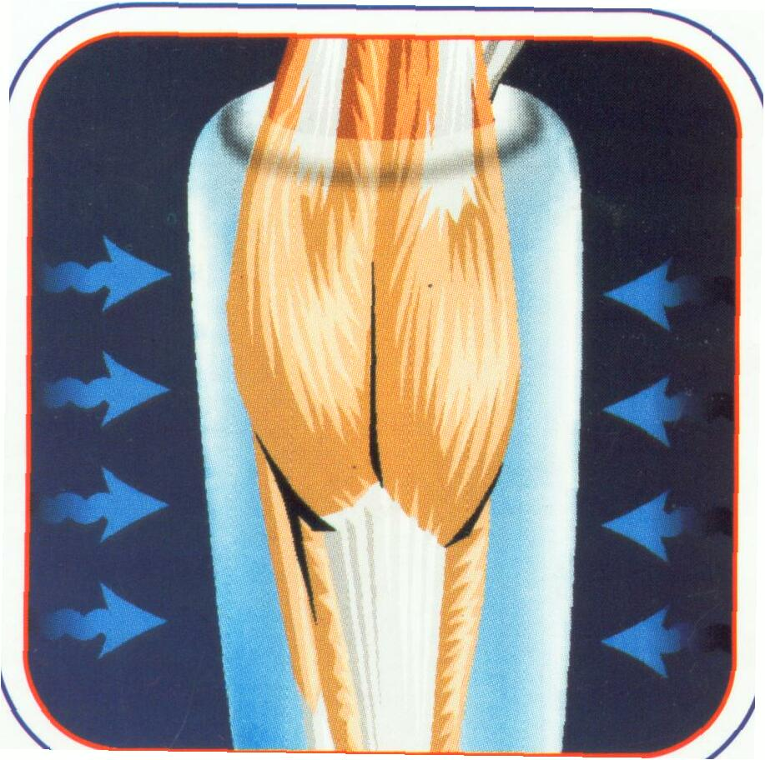
Venodyne's compression cycle -12 seconds of 40-45 mm Hg pressure followed by 48 seconds of relaxation - results in complete venous clearance.
Production rates of prostacyclin are twice as great in cells subjected to pulsatile shear stress as in cells exposed to steady shear stress.
Intermittent compression also results in an increase in plasma fibrinolytic activity.

Slide 60
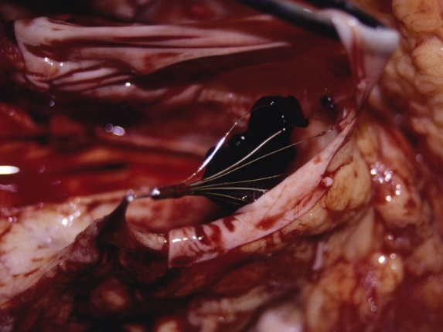
Vena Caval Filters
5 filter types-all equal efficacy
Pulmonary embolism 2.6%-3.8%
Deep Venous Thrombosis 6%-32%
Insertion site thrombosis 23%-36%
Inferior caval thrombosis 3.6%-11.2%
Postphlebitic syndrome 14%-41%
Streiff Blood 2000; 95:3669-77

Slide 61
VTE Treatment Algorithm

Slide 62
Summary
Venous thromboembolism is common in medical, surgical as well as critically ill patients
Modifiable risk factors are limited in ICU
DVT prophylaxis is essential
PE risk stratification is crucial to define optimal Tx

Slide 63
Conclusion
DVT IS A SILENT KILLER
PE IS A COMMON SEQUEL OF THIS SYNDROME
EQUAL INCIDENCE IN MEDICAL OR SURGICAL
PROPHYLAXIS IS THE ONLY WAY OUT!
HEPARIN, LMWHs, & OTHERS EFFECTIVE
PNEUMATIC DEVICES -PROMISING

Slide 64
THANK YOU !

